Slide 1
Retirement income planning
Planning for income to last your lifetime
Not FDIC Insured • May Lose Value • No Bank Guarantee

Slide 2
You may be retired for longer than you think
Questions to consider
Will I be able to
meet all my expenses?
Can I retire now,
or should I wait?
Will I be able to
maintain my lifestyle?
How should my
assets be allocated?
Will my
money last?
Notes:
2
We’re going to cover a lot of ground today as we share with you the importance of creating a Retirement Income Plan. Recognizing the need for a written retirement income plan is the first step. The second is recognizing that you don’t have to do this alone—your financial representative and Fidelity are here to help. You may have questions, such as:
Will I be able to maintain my lifestyle?
Will I be able to meet all my expenses?
Can I retire now? Or should I wait?
How should my assets be allocated?
But the biggest question of all—and the most pressing concern for the majority of retirees and pre-retirees I speak with—is: Will my money last? Some of you may also be wondering if you will have money left over to leave to your loved ones.
These are some of the many questions that probably brought you here today. They’re the questions we hear time and time again.
But if there’s one thing we’ve learned—and if there’s one thing I want you to come away with today—it’s that you should consider a practical, useable plan to navigate this new retirement territory. And today I’m going to show you how easy it can be to come up with one.
Transition
Let’s look at where your retirement income might come from.

Slide 3
Where will retirement income come from?
Source: Income for the Population Aged 65 and Older: Evidence from the Health Retirement Study (HRS), August 5, 2025.
Notes:
3
It’s important because the retirement territory has changed.
So, what do I mean by the “new retirement territory”?
Retirement for our parents, and perhaps our grandparents, was very different. Many people counted on Social Security and pension benefits to cover their retirement income needs. But today, retirees will be more personally responsible for funding their own retirements.
Take a look at this chart. It shows that Social Security isn’t the only significant source of income for those over 65. Much of household income also comes from pensions and retirement savings, asset income, and earnings.
Your expectations around lifestyle may be higher than those of your grandparents, which may also mean you’re spending more. The good news is that you’ve probably saved more than your grandparents, and you may have spent your entire lives in the stock market. Of course, this has added yet another layer of complexity to your situation, making it important that you have a road map to chart your way through the new territory ahead.
Transition
Let’s review the agenda.

Slide 4
Agenda
Learn the financial risks of retirement
Understand the benefits of creating a retirement income plan
Use available planning resources
Take the next step!
Notes:
OPTIONAL SLIDE
We’ll start today’s program with a discussion of the new retirement territory and the financial risks each of us face in retirement. Some of these risks, like inflation and market fluctuations, will be familiar.
Others will be new—and potentially worrisome. But you can count on the fact that by the end of this presentation, you will be armed with the knowledge and strategies you need to face all of these risks head on. And your financial representative will be there to make it easier for you, every step of the way.
We’ll also examine how creating a written income plan can help you in planning for retirement. Finally, we’ll discuss the next steps you’ll need to take to begin creating your own plan. That’s where your financial representative, who will work with you until the process is complete, can be a most valuable resource.
If providing handouts to audience: (optional materials include Shareholder Worksheet and Shareholder Guide)
Transition
Now I just want to bring your attention to the handouts in front of you.
[Review and explain the items you have handed out to the audience]

Slide 5
Five key risks of retirement
  RISK 1
  Longevity
  RISK 2
  Medical
  RISK 3
  Inflation
  RISK 4
  Allocation
  RISK 5
  Withdrawals
Notes:
5
Before you can embark upon building a practical road map to financial security, you need to understand—and integrate into your plan—five key risks that can potentially derail a lifetime income plan.
These risks …
Longevity
Health care expenses
Inflation
Asset allocation
Excess withdrawal
… are those that we feel every pre-retiree and retiree should plan for. We’re going to discuss each of these in greater detail.

Slide 6
Longevity
Plan for living longer than you think
Male
Age 65
50% Chance of reaching age
86
25% Chance of reaching age
91
Female
Age 65
50% Chance of reaching age
88
25% Chance of reaching age
94
Couple
Both Age 65
50% Chance of one spouse surviving
92
25% Chance of one spouse surviving
96
Age
Source: The American Academy of Actuaries and the Society of Actuaries Research Institute have developed this longevity illustrator to help you understand your financial longevity risk in retirement so you can think about strategies for managing your financial resources to last your lifetime, as well as your spouse/partner’s lifetime. This tool is not designed to be a financial planner. The Actuaries Longevity Illustrator does not predict how long you can expect to live. There are many factors that affect how long you might live, and this tool reflects only a few of them. The Actuaries Longevity Illustrator provides reasonable estimates based on average expectations. However, average expectations may or may not reflect your situation, and your actual lifetime could be significantly longer or shorter than these illustrations. In addition, this longevity illustrator assumes you will live until the retirement age you entered. It is intended to help you understand your longevity risk after you retire, not to illustrate your chances of living until your retirement age. This chart assumes a couple at age 65 who do not smoke and are of average general health.
Notes:
6
OPTIONAL SLIDE
A retirement income plan may help to ensure that your assets last as long as your retirement. When thinking about how long they might need income, many people tend to think in terms of life expectancy. But statistically, half of the population will live longer than their expectancy, which means that they will underestimate how long they will need their savings to last. As this slide shows, an American man who has reached age 65 in good health, for example, has a 50% chance of living to age 86, and one chance in four of living to 91. For a 65-year-old woman, those odds rise to a 50% chance of making it to age 88 and a 25% chance of living to 94. The odds that at least one member of a 65-year-old couple will live to 92 are 50%. And there is a 25% chance that one member of that couple will live to 96. As a result you should consider planning for income to last well into your 90s. Transition Now let’s consider health care expenses.
Transition
Now let’s consider health care expenses.

Slide 7
Health care expenses
Saving for rising costs
47% Other medical expenses
Including co-payments, coinsurance, and
deductibles for doctor and hospital visits
$345,000
Out-of-pocket health care expense estimate for a 65-year-old couple
44% Medicare Part B and Part D premiums
Doctor appointments and hospital visits
9% Generics, branded drugs, specialty drugs
Source: 2025 Fidelity Retiree Health Care Cost Estimate and Fidelity Benefits Consulting, 2025. See Important information section for methodology.
Notes:
Longer life spans, rising medical costs, declining employer-sponsored medical coverage, and possible shortfalls ahead for Medicare all add up to make health care expenses a critical challenge for retirees and pre-retirees alike.
Transition
Now we’ll learn something about inflation.

Slide 8
Inflation
Even low inflation could damage purchasing power
$60,000
$50,000
$50,000
$40,000
Dollars
$30,000
$30,477 | 2% Inflation
$23,880 | 3% Inflation
$20,000
$18,756 | 4% Inflation
$10,000
$0
Today
5 Years
10 Years
15 Years
20 Years
25 Years
Years From Retirement Start Date
All numbers were calculated based on hypothetical rates of inflation of 2%, 3%, and 4% (historical average from 1926 to 2022 was 3%) to show
the effects of inflation over time; actual inflation rates may be more or less and will vary.
Notes:
8
OPTIONAL SLIDE
Inflation is the long-term tendency of money to lose purchasing power. And it can have a particularly negative effect on retirees because it chips away at retirement income in two ways:
• Increases the future cost of goods and services
• Potentially erodes the value of assets set aside to meet those costs
As this slide reveals, even a relatively low inflation rate of 2% can have a significant impact on a retiree’s purchasing power. For example, $50,000 of income today may only be worth $30,477 in 25 years based upon a 2% inflation rate. At 3% it would fall by more than half to just $23,880; at 4% the decline is even more extreme.
The strong likelihood of continuing inflation makes it imperative that your retirement savings include investments with the potential to beat inflation—especially considering the longer retirement that today’s retirees can anticipate. As a further example, who here remembers the cost of a gallon of milk in 1970? Probably 65 cents. Today that same gallon of milk could cost more than 4 dollars! The same holds true for just about anything you can think of: a loaf of bread, a pair of shoes.
Transition
Next up: asset allocation.

Slide 9
Asset allocation
Retirees need stocks for the long haul
Comparison of average annual rising costs vs. average annual investment returns, 1926–2024
Examples of target asset mixes
designed to meet various goals³
Conservative
14% Stocks, 6% Foreign Stocks, 50% Bonds, 30% Short-Term
Balanced
35% Stocks, 15% Foreign Stocks, 40% Bonds, 10% Short-Term
Growth
49% Stocks, 15% Foreign Stocks, 25% Bonds, 5% Short-Term
Aggressive Growth
60% Stocks, 25% Foreign Stocks, 15% Bonds
Rising
costs
Annual average portfolio returns
(1926–2024)
8.89%
9.62%
7.83%
5.01%
5.78%
2.9%
Inflation¹
Health
care costs²
Conservative
Balanced
Growth
Aggressive growth
¹ Source: December 2024 BLS report.
² Data for health care costs is from the Centers for Medicare and Medicaid Services, National Health Expenditures Estimates 2024–2033.
³ Stocks are composed of domestic and foreign stocks.
Fidelity Investments and Morningstar Inc. Hypothetical value of assets held in untaxed portfolios invested in U.S. stocks, foreign stocks, bonds, or short-term investments. Stocks, foreign stocks, bonds, and short-term investments are represented by total returns of the IA SBBI US Large Stock TR USD Ext 1/1926-1/1987, Dow Jones Total Market from 2/1087 to 12/2024; IA SBBI US Large Stock TR USD Ext 1/1926 to 12/1969, MSCI EAFE 1/1970 to 11/2000, MSCI ACWI Ex USA GR USD 12/2000 to 12/2024; U.S. Intermediate-Term Government Bond Index from 1/1926 to 12/1975, Barclays Aggregate Bond from 1/1976 to 12/2024; and IA SBBI US 30-Day T-Bills 1/1926 to 12/2024. Past performance is no guarantee of future results
Notes:
Some people fear losing their nest egg, so they avoid stocks and stick with fixed income investments. But by doing this they may give up long-term growth potential and risk outliving their money.
Market risk comes with investing. While we can’t control market behavior, we may be able to manage its long-term effects through our investment choices. One option is asset allocation, which strives to strike a balance between stocks, bonds, and short-term investments.
The graph shows how various asset allocations have fared compared with inflation and health care costs. A conservative portfolio has kept up—but just barely. Greater exposure to equities may give a portfolio the “breathing room” necessary for long-term financial security. But remember, asset allocation does not ensure a profit or guarantee against a loss.
NOTE TO SPEAKER
(Please read)
In the example shown on the slide, the asset allocations are defined as follows:
Conservative: 14% Stocks, 6% Foreign Stocks, 50% Bonds, 30% Short-Term
Balanced: 35% Stocks, 15% Foreign Stocks, 40% Bonds, 10% Short-Term
Growth: 49% Stocks, 15% Foreign Stocks, 25% Bonds, 5% Short-Term
Aggressive Growth: 60% Stocks, 25% Foreign Stocks, 15% Bonds
Generally, among asset classes, stocks may present more short-term risk and volatility than bonds or short-term instruments but may provide greater potential return over the long term. Although bonds generally present less short-term risk and volatility than stocks, bonds contain interest rate risk (as interest rates rise, bond prices usually fall); the risk of issuer default; and inflation risk. U.S. Treasury bills maintain a stable value (if held to maturity), but returns are generally only slightly above the inflation rate. Foreign investments, especially those in emerging markets, involve greater risk, but may offer greater potential return than U.S. investments.
The target asset mixes are hypothetical models and illustrate certain examples of many possible combinations of investment allocations that could help an investor pursue his or her goals; these target asset mixes do not constitute investment advice under the Employee Retirement Income Security Act of 1974 (ERISA). You should choose your own investments based on your particular objectives and situation.
Remember that diversification and asset allocation does not ensure a profit or protect against loss, and past performance is no guarantee of future results.
TRANSITION
Let’s see how withdrawal rates influence asset allocation.

Slide 10
Excess withdrawal
Sustainable withdrawal rates can extend the life of a portfolio
How a couple retiring in 1972 with $500,000 is affected.
50% Stock, 40% Bonds, 10% Short-term Investments 1972–2012
Withdrawals are inflation adjusted*
$2,000,000
Dollars Remaining
$1,000,000
A couple, both age 65, would have run out of money at age 88 if they had withdrawn 5%, adjusted upwards for inflation each year.
4%
$500,000
10%
9%
8%
7%
6%
5%
$0
1972
1974
1976
1978
1980
1982
1984
1986
1988
1990
1992
1994
1996
1998
2000
2002
2004
2006
2008
2010
2012
Hypothetical Couple
(both age 65)*
100% at Age 65
99% at
Age 70
98% at
Age 75
94% at
Age 80
86% at
Age 85
68% at
Age 90
39% at
Age 95
Source: Fidelity Investments. Hypothetical value of assets held in an untaxed account of $500,000 invested in a portfolio of 50% stocks, 40% bonds, and 10% short-term investments with inflation-adjusted withdrawal rates as specified. This chart uses historical monthly performance from January 1972 through December 2012 from Ibbotson Associates; stocks, bonds, and short-term investments are represented by the S&P 500, U.S. Intermediate-Term Government Bonds, and U.S. 30-day T-bills, respectively. You cannot invest directly in an index. This chart is for illustrative purposes only, is not indicative of any investment, and is not intended to project or predict the present or future value of the actual holdings in a participant’s portfolio or the performance of a given model portfolio of securities.
See Important information section for further details about indices. Past performance is no guarantee of future results.
* Probability of a couple’s joint and survivorship to various ages is based on Society of Actuaries RP-2014 Mortality Table projected with Mortality
Improvement Scale MP-2021.
Figures assume healthy annuitants. Past performance is no guarantee of future results.
Notes:
10
OPTIONAL SLIDE
Even the savviest asset allocation strategy can misfire without an equally wise strategy for withdrawing assets. The withdrawal rate can dramatically affect how long the money will last. This is a variable that’s largely in the retiree’s control.
Until recently, many people may have expected overly optimistic withdrawal rates of 7%, 8%, or even more per year, believing they could count on rising stock prices to keep the total value of their investments unchanged—or even growing. The gravity of the most recent market correction has exposed that fallacy.
Let’s see how different withdrawal rates may affect the life of a pool of assets. This slide takes a balanced portfolio of $500,000 and tracks it over the period from 1972 to 2012 using a range of inflation-adjusted withdrawal rates.
As you can see, a 4% withdrawal rate—$20,000 in the first year and then adjusted each year for actual historical inflation—is the only one of the scenarios that would have sustained the asset pool and produced income throughout the couple’s projected lifetime.
NOTE TO PRESENTER
Please read all disclosures to meeting attendees.
TRANSITION
Now that we have covered the five risks retirees face, let’s move on to the retirement income planning process.

Slide 11
Let’s work together to create a plan
What is a retirement income plan?
A detailed plan that you and your financial representative create to determine
how to use your assets to generate income that may last for the rest of your life.
A retirement income plan can help you:
Minimize the
key risks
Identify sources
of income
Stay on track to live the retirement you want
Notes:
Think of all you’ve learned so far. You already have a better idea of:
how long your savings and investments may need to last;
how much you may need to allow for health care expenses;
how much your income may need to increase to keep pace with inflation;
how risky it may be to invest too conservatively;
how much you may be able to withdraw each year.
Now what can you do with all you’ve learned? Well, there’s no time like the present to start working with your financial representative to create a sound retirement income plan for the next chapter of your financial life.
A retirement income plan is a detailed plan crafted by you and your financial representative. This plan spells out how you’re going to use your assets to generate income that may continue for the rest of your life. And you should go back periodically and review whether you’re on track with your plans. How many of you already have such a detailed plan? [Solicit feedback.]
There are many, many benefits of developing a retirement income plan. First of all, it can help minimize the risk that you may outlive your assets. But it can also help maximize the potential for living the life you want.
A retirement income plan can also help streamline your financial life throughout retirement. You could spend a great deal of time trying to make sense of many different income sources, including a pension, 401(k), investments, and Social Security, as well as other sources of income. Imagine if you had one consolidated plan for how to spend and invest those resources.
Transition
Let’s look at the four steps in creating a plan.

Slide 12
Retirement income planning process
1
2
3
4
Inventory expenses
vs. income
Cover essential expenses
Fund discretionary expenses
Review plan regularly
Notes:
There are four key steps to this process. In working with many retirees, I can tell you this. Most people find this process helpful. And it can be confidence-building to develop specific strategies tailored for your situation. Here are the steps:
Inventory expenses vs. income
Cover essential expenses
Fund discretionary expenses
Review plan regularly
Notice that last item. This isn’t a “one-and-done” process, so you’ll also need to commit to examining your plan regularly. Over time, your priorities may shift, your situation may change. This plan is designed to be structured yet flexible, so we can make adjustments over time to reflect your changes.
Transition
Let’s review each step individually, then go through a couple of examples and look at portfolio construction.

Slide 13
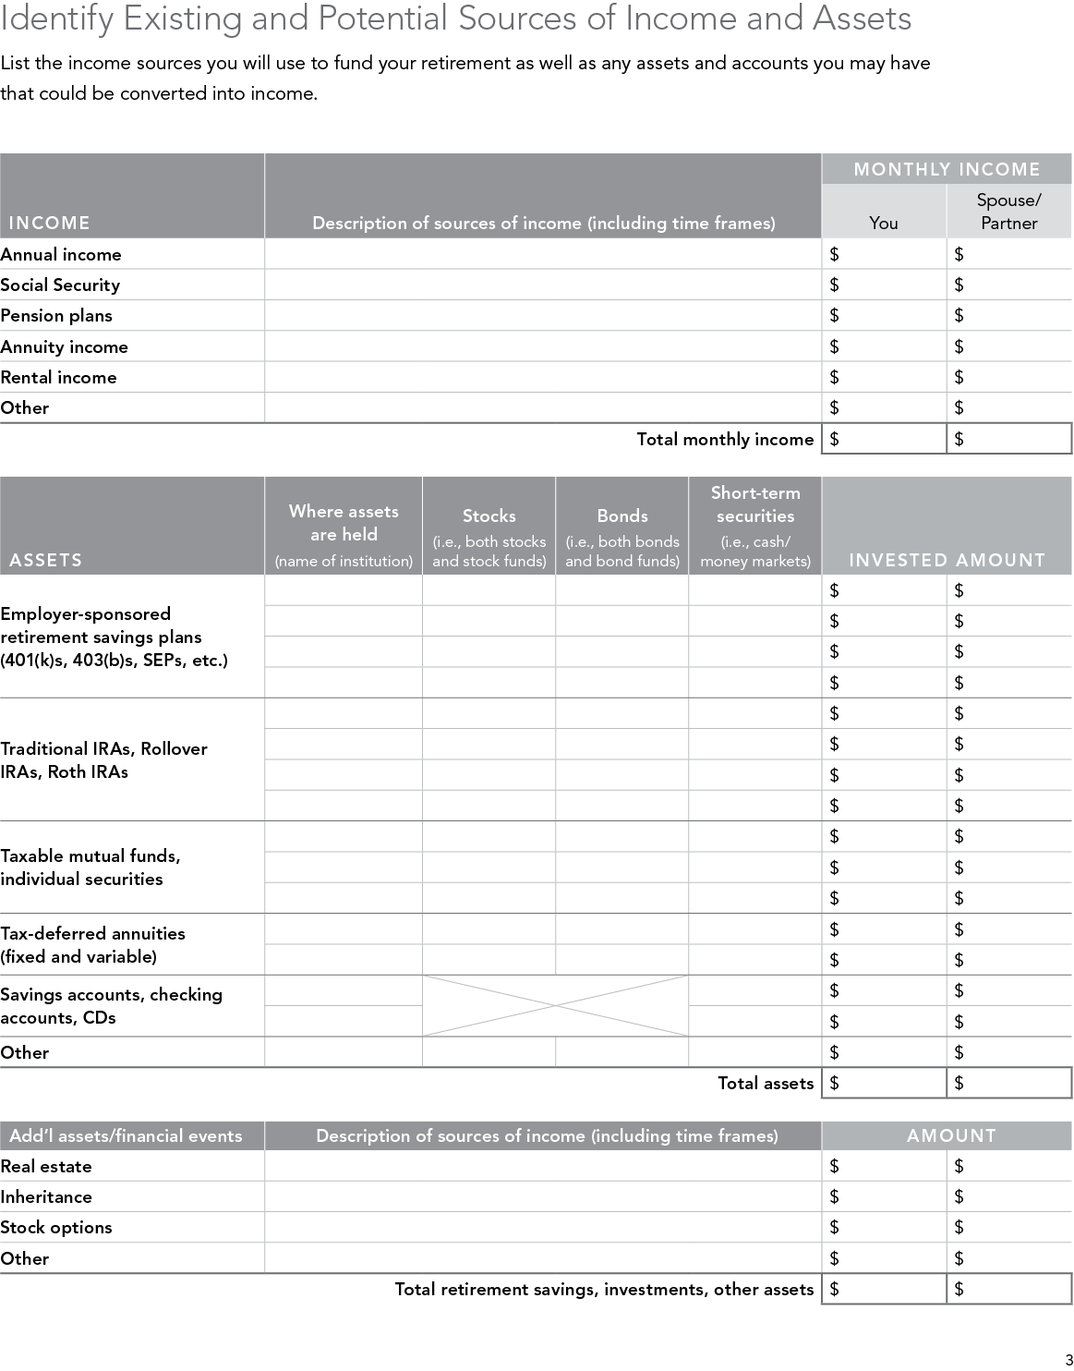
Inventory expenses vs. income
1
Distinguish between your essential and discretionary expenses
Consider which expenses may increase and which may decrease in retirement
Consider long-term care coverage
Notes:
13
Here’s where you will map out different groupings of expenses and income sources. It’s where you will likely identify all of the other assets you hold, along with any long-forgotten savings.
Distinguish between your essential and discretionary expenses. Essential expenses are those that you absolutely must have money for—housing, health care, food, etc. For some, essentials include memberships to clubs or a certain amount of travel. Give some thought to what you consider to be essential.
Discretionary spending, such as travel, hobbies, entertainment, etc., will need to be covered with any remaining assets.
Consider which expenses may increase and which may decrease in retirement. While some expenses may decrease in retirement (you’re likely to spend less on work clothing, for example), other expenses, such as health care, are almost certain to increase. And since long-term care can be costly, you may also wish to consider coverage specifically for this potential expense.
Transition
The next step is to identify sources of income to cover expenses.

Slide 14
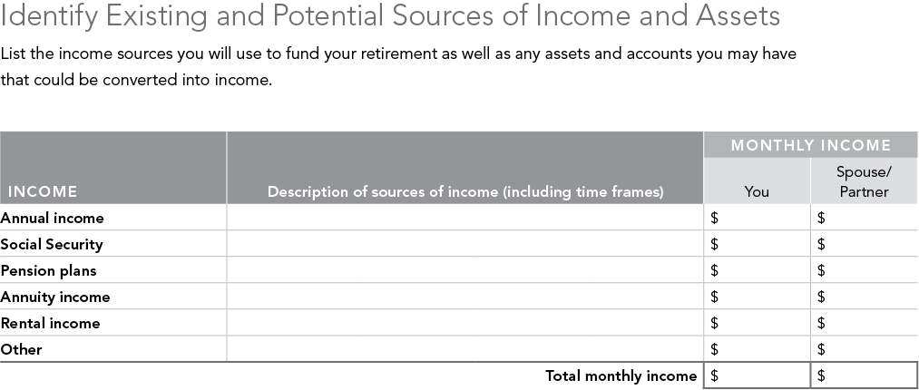
Estimate income sources
1
Inventory your assets and
how they are invested
Identify lifetime income sources
Social Security
Pensions
Annuities
Identify other income sources
Part-time employment
Rental income
Real estate
Notes:
14
Once you’ve estimated your expenses, you should consider identifying the resources you can tap to pay for them. You may also want to highlight which of these sources can actually provide you with lifetime income—payments that will continue for the rest of your life. Typically these include Social Security, pensions, and annuities.
In addition, any inheritance or other windfall you may be expecting should be considered as part of your income plan.
Transition
Now we’ll look at using these sources to cover expenses.

Slide 15
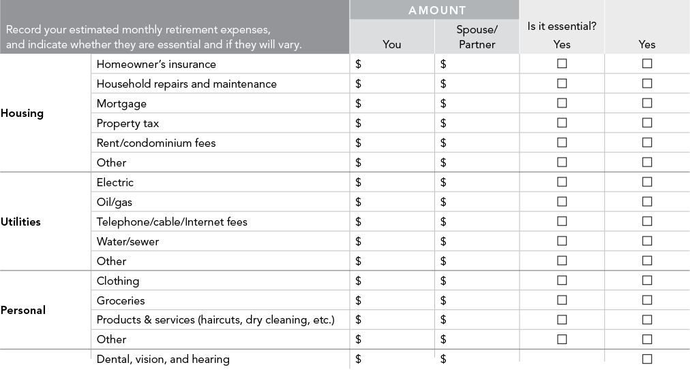
Cover essential expenses
2
Earmark lifetime income
sources ...
Identify lifetime income sources
Social Security
Pensions
Annuities
or
Regular withdrawals from reliable asset sources
... to pay for essential expenses.
Notes:
15
You may wish to consider using reliable sources of lifetime income to pay for your essential expenses such as housing [called out on slide], which can include:
Homeowner’s insurance
Household repairs and maintenance
Mortgage
Property tax
Rent/condominium fees
Other
Reliable sources include income from Social Security, employer pensions, annuities, or regular withdrawals from reliable asset sources.
In the case of a surplus, allocate assets toward other financial goals—funding discretionary expenses, charitable giving, or legacy planning.
Transition
But what if there’s a shortfall?

Slide 16
Fill any essential expense gap
2
Consider using a portion of your assets to ...
Purchase an income annuity to guarantee lifetime income*
Set up a systematic withdrawal plan to generate income
or
... and consider long-term care and life insurance
to cover potential health cost needs
* Guarantees are subject to the claims-paying ability of the issuing insurance company.
Notes:
If you find you have a shortfall between your lifetime income sources and your essential expenses, your financial representative can walk you through several possible strategies.
Overall, to cover this expense gap for your lifetime, you may want to consider converting a portion of your income sources into a lifetime income source.
How do you do that? Well, there are a few options to consider. You could consider using a portion of your assets to purchase an income annuity. An income annuity immediately converts a one-time purchase payment into a stream of income payments guaranteed by the issuer to continue for the rest of your life. (Guarantees are subject to the claims-paying ability of the issuing insurance company.)
You could also consider earmarking a portion of your assets to pay for your essential expenses. Again, your financial representative could help you set up a systematic withdrawal plan that would automatically take withdrawals from these assets to generate the income you need to cover your essential expenses.
In addition, you may want to consider some added protection for your health care costs. Ask your financial representative about long-term care insurance as well as life insurance to plan for your health care expenses being adequately covered.
Transition
Now let’s consider some decisions about Social Security.

Slide 17
Social Security considerations
2
When to start
Start collecting Social Security at this age: | 62 | Full Retirement Age 67 | 70
Receive this much initially per year | $19,560 | $29,424 | $37,212
Live to age 70, and receive a total of | $156,480 | $88,272 | $0
Live to age 80, and receive a total of | $352,080 | $382,512 | $372,120
Live to age 90, and receive a total of | $547,680 | $676,752 | $744,240
This hypothetical chart is for illustrative purposes only. The Social Security benefits above are based on one person’s hypothetical work history. It assumes the following: 1) person is age 55 in 2025 with a full retirement age of 67; 2) person has pretax income of $75,000 in 2025, all subject to Social Security taxes; 3) person works until benefits are collected; 4) all benefits are shown in today’s dollars, pretax; 5) once benefits begin, there is no reduction in benefits due to earned income on or before the full benefit age; 6) cumulative benefit amounts are calculated as initial benefit amount multiplied by the number of years. The cumulative total is not a future savings balance from investing Social Security retirement benefits received; 7) taxes are not taken into account. If they were, amounts would be lower. Benefit estimates were obtained from the Social Security Administration’s Online Quick Calculator at www.ssa.gov. This calculator is periodically updated.
Notes:
Remember getting those statements from the Social Security administration in the mail? If you dared to look, these statements estimated different benefit amounts at age 62, at your “full retirement age,” and at age 70. That’s because when you start collecting will affect how much you’ll receive. This chart shows how much money hypothetical retirees may receive from Social Security, depending on when they begin collecting and how long they live. Let’s review each of these options, because it’s important for you to know how much reliable income you may expect each year.
Option 1: Wait until you’re eligible for “full benefits.” Currently, that age is somewhere between age 65 and age 67, depending on the year you were born. But just because the government calls this the full retirement age doesn’t mean it’s the right age for you. For some retirees, it may be better to collect earlier even though they’ll receive a smaller monthly benefit payment. Others may want to hold out even longer for potentially larger benefit payments.
Option 2: Start collecting earlier. You can collect benefits as early as age 62, although the monthly benefits you receive may be reduced by up to 30%. Exactly how much less you’ll receive per month depends on how much earlier you collect (as you can see on this chart). You may want to consider this option if you need or want to retire early; you haven’t stashed much away in retirement savings plans; or you don’t expect to live past “life expectancy.”
Option 3: Further defer payments. You don’t have to start collecting at your full retirement age, either. You could defer your payments until age 70. For every year you delay payments up until age 70, your monthly Social Security payments could increase by approximately 5% to 8%. You may want to consider this option if you have other sources of income, or if you expect to live a long, healthy life, thanks to your family’s own history of longevity and/or ongoing medical advances.
Remember, the longer you can wait, the higher the monthly benefit you’ll receive—for the rest of your hopefully long life.
You may want to obtain a personal estimate of your potential Social Security benefits by visiting www.ssa.gov.
Transition
Let’s now examine how to fund discretionary expenses.

Slide 18
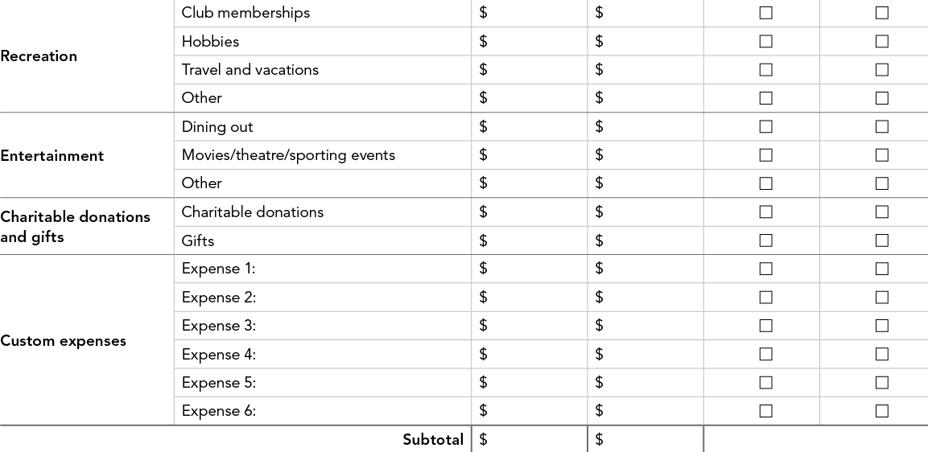
Fund discretionary expenses
3
Use income from
remaining assets ...
Mutual funds
Brokerage accounts
IRAs, 401(k)s
Savings accounts
... to pay for your
discretionary expenses.
Notes:
Discretionary expenses are those dreams that all of us have for retirement. Traveling, visiting the grandkids more often, exploring new hobbies, etc. Each of you will have different points of view on your “lifestyle” needs in retirement.
To pay for these discretionary expenses, you may decide to invest the assets that remain after funding the essential expenses, using a strategy designed to provide discretionary income. Again, you may need to employ a reasonable, sustainable withdrawal rate from this asset pool. And acknowledge that as this is a discretionary pool, the market ups and downs could impact the amount you receive each year.
Your financial representative can help you determine how to construct your portfolio for your discretionary spending.
Transition
Let’s take a look at how different income strategies may impact your discretionary assets.

Slide 19
Consider income strategies
3
Possible income strategies to explore:
Interest
only
Bridge
Systematic
withdrawals
Live off the interest from your fixed income investments
Segregate some assets for immediate income and invest the balance to potentially replenish income sources
Set up pro rata withdrawals across a well-balanced
portfolio
Notes:
The first of these strategies is “Interest Only”—this is the strategy that many of you will be most familiar with—“protection of principal” and living off the interest only.
The goal of the interest pool is to provide potential target income through dividends and interest from bonds and short-term instruments.
The second strategy, a “Split” or “Bridge” strategy, takes all remaining assets set aside for discretionary retirement income and splits them into two buckets: one designed to meet certain specific income goals over a specific and defined period of time, and another designed to allow for portfolio growth and management of the five key risks.
The goal is to provide target income for a specified amount of time that bridges a gap (for example, 5 years, from 62 to 67 when full Social Security becomes available for certain retirees, or from say, 65 to 70½—before RMDs must begin) while allowing a significant portion of your portfolio to remain invested for growth for the longer term.
The dedicated income pool will be drawn down to $0 at the end of the period, while the growth “bucket” has been invested in your chosen asset allocation and left untouched with the goal of regenerating the original amount and possibly increasing it (dependent upon market conditions).
The final strategy, a “Systematic Withdrawal Plan,” sets all remaining assets aside for discretionary retirement income and allocates them based on your target asset mix. We discussed some of the benefits of a balanced portfolio earlier, and suggest that investing in an appropriate mix of equities, bonds, and short-term instruments may help generate current income needs and provide opportunity for growth to the portfolio for the long run. Your financial representative can assist you in determining an appropriate asset allocation strategy.
Then—annually, quarterly, or monthly—the assets are liquidated systematically on a pro rata basis, and are distributed to you for your target income needs.
The goal is to provide target income while maintaining the asset allocation mix over your lifetime. A balanced or growth portfolio may be considered with this strategy to try to address the combined impact of inflation, longevity, and asset allocation.
Transition
Now let’s look at how to determine an appropriate target asset mix.

Slide 20
Determine your target asset mix
3
Key factors to consider with
your financial representative
Time horizon
Risk tolerance
Investment experience
Financial situation
Bonds
Target
Asset
Mix
Short-
term
Equities
Notes:
20
For the first part of the investing phase you’ll need to determine your target asset mix for your investments. For those of you unfamiliar with this term, it refers to the appropriate mix of assets—stocks, bonds, and short-term investments—for an investor based upon your:
Time horizon. How long you expect you’ll need your assets to last.
Risk tolerance. How willing you are to endure the market’s ups and downs in exchange for more growth potential over the long term.
Investment experience. Your experience in investing in stocks and bonds, and whether you have the interest, time, and know-how to manage your own investments.
Financial situation. Including your lifestyle and assets.
Transition
Next: the ongoing step…

Slide 21
Monitor your plan each year
4
Meet with your financial representative at least once a year to:
Review
retirement income goals
Reassess expenses
Rebalance portfolio
Update
your beneficiary designations
Notes:
21
This step isn’t one you take once. It’s one you’ll take each year. Step 4 stresses the importance of examining your plan regularly.
At least once a year, you may want to meet with your financial representative to see whether your plans are on track. Together you’ll:
Review retirement income goals
Reassess expenses
Rebalance portfolio
Update your beneficiary designations
Remember, I said your income plan would be structured yet flexible. So you’ll be able to make adjustments as you need to over time … based on the same careful analysis with which you built it in the first place.
Transition
Now it’s time to take action.

Slide 22
Let’s get started
4
Complete your Shareholder Worksheet.
Schedule your one-on-one consultation:
[Rep Name]
[Title]
[Phone #]
[Website Address]
[eMail Address]
Notes:
22
OPTIONAL SLIDE
So are you ready to get started? Are you feeling more in control and primed to turn all of this information into a plan that’s customized for you? Think how much better you may feel when this is done.
Don’t put it off. Complete the worksheet we discussed in this seminar so that you and your spouse can discuss your essential expenses, discretionary expenses, and all your resources that may be available to generate retirement income.
I hope you’ve found today’s presentation informative and encouraging. You’ll find that creating a holistic income plan may be simpler—and more reassuring—than you thought.
[Encourage people to fill out the shareholder worksheet. Ask if you can address any general questions.]

Slide 23
Important information
IMPORTANT: The projections regarding the likelihood of various investment outcomes are hypothetical in nature, do not reflect actual investment results, and are not guarantees of future results. Results may vary with each use and over time. Although past performance does not guarantee future results, it may be useful in comparing alternative investment strategies over the long term. Performance returns for actual investments will generally be reduced by fees or expenses not reflected in these hypothetical illustrations.
Charts on slides 8 and 9 are not intended to project or predict the present or future value of the actual holdings in a participant’s portfolio or the performance of a given model portfolio of securities.
On slide 9: Generally, among asset classes, stocks may present more short-term risk and volatility than bonds or short-term instruments but may provide greater potential return over the long term. Although bonds generally present less short-term risk and volatility than stocks, bonds contain interest rate risk (as interest rates rise, bond prices usually fall); the risk of issuer default; and inflation risk. U.S. Treasury bills maintain a stable value (if held to maturity), but returns are generally only slightly above the inflation rate. Foreign investments, especially those in emerging markets, involve greater risk, but may offer greater potential return than U.S. investments.
The target asset mixes are hypothetical models and illustrate certain examples of many possible combinations of investment allocations that could help an investor pursue his or her goals; these target asset mixes do not constitute investment advice under the Employee Retirement Income Security Act of 1974 (ERISA). You should choose your own investments based on your particular objectives and situation.
Methodology and information
For the charts shown on slides 9 and 10, which highlight varying levels of stocks, bonds, and short-term investments, the purpose of these hypothetical illustrations is to show how portfolios may be created with different risk and return characteristics to help meet a participant’s goals. You should choose your own investments based on your particular objectives and situation. Remember, you may change how your account is invested. Be sure to review your decisions periodically to make sure they are still consistent with your goals. You should also consider all of your investments when making your investment choices.
All index returns include reinvestment of dividends and interest income. It is not possible to invest directly in any of the indices described above. Investors may be charged fees when investing in an actual portfolio of securities, which are not reflected in illustrations utilizing returns of market indices.
Index definitions
Standard & Poor’s 500 index (S&P 500) is a market capitalization-weighted index of 500 widely held U.S. stocks and includes reinvestment of dividends.
U.S. Intermediate-Term Government Bond Index is an unmanaged index that includes the reinvestment of interest income.
MSCI EAFE (Europe, Australasia, Far East) Index is an unmanaged market capitalization-weighted index that is designed to represent the performance of developed stock markets outside the United States and Canada and assumes the highest possible withholding taxes are applicable.
The Consumer Price Index is a widely recognized measure of inflation calculated by the U.S. government.
U.S Treasury bills are backed by the full faith and credit of the U.S government.

Slide 24
Important Information (continued)
For investor use.
Unless otherwise expressly disclosed to you in writing, the information provided in this material is for educational purposes only. Any viewpoints expressed by Fidelity are not intended to be used as a primary basis for your investment decisions and are based on facts and circumstances at the point in time they are made and are not particular to you. Accordingly, nothing in this material constitutes impartial investment advice or advice in a fiduciary capacity, as defined or under the Employee Retirement Income Security Act of 1974 or the Internal Revenue Code of 1986, both as amended. Fidelity and its representatives may have a conflict of interest in the products or services mentioned in this material because they have a financial interest in the products or services and may receive compensation, directly or indirectly, in connection with the management, distribution, and/or servicing of these products or services, including Fidelity funds, certain third-party funds and products, and certain investment services. Before making any investment decisions, you should take into account all of the particular facts and circumstances of your or your client’s individual situation and reach out to an investment professional, if applicable.
The retirement planning information contained herein is general in nature. It is not intended to be, and should not be construed as, legal or tax advice. Fidelity does not provide legal or tax advice. Laws of a specific state or laws relevant to a particular situation may affect the applicability, accuracy, or completeness of this information. Consult an attorney or tax advisor regarding your specific legal or tax situation.
The 2025 Retiree Health Care Cost estimate is based on a single person retiring in 2025, 65-years-old, with life expectancies that align with Society of Actuaries' RP-2014 Healthy Annuitant rates projected with Mortality Improvements Scale MP-2020 as of 2022. Actual assets needed may be more or less depending on actual health status, area of residence, and longevity. Estimate is net of taxes. The Fidelity Retiree Health Care Cost Estimate assumes individuals do not have employer-provided retiree health care coverage, but do qualify for the federal government’s insurance program, original Medicare. The calculation takes into account Medicare Part B base premiums and cost-sharing provisions (such as deductibles and coinsurance) associated with Medicare Part A and Part B (inpatient and outpatient medical insurance). It also considers Medicare Part D (prescription drug coverage) premiums and out-of-pocket costs, as well as certain services excluded by original Medicare. The estimate does not include other health-related expenses, such as over-the-counter medications, most dental services, and long-term care.
Third-party trademarks and service marks are the property of their respective owners. All other trademarks and service marks are the property of FMR LLC or an affiliated company.
Not NCUA or NCUSIF insured. May lose value. No credit union guarantee.
Diversification does not ensure a profit or guarantee against a loss.
Investing involves risks, including risk of loss.
Approved for use in Advisor and 401(k) markets. Firm review may apply.
Fidelity Investments ® provides investment products through Fidelity Distributors Company LLC; clearing, custody, or other brokerage services through National Financial Services LLC or Fidelity Brokerage Services LLC (Members NYSE, SIPC); and institutional advisory services through Fidelity Institutional Wealth Adviser LLC.
Personal and workplace investment products are provided by Fidelity Brokerage Services LLC, Member NYSE, SIPC.
Before investing, consider the funds’ investment objectives, risks, charges, and expenses. Contact your investment professional or visit institutional.fidelity.com for a prospectus or, if available, a summary prospectus containing this information. Read it carefully.
435747.35.0
Fidelity Distributors Company LLC, 900 Salem Street, Smithfield, RI 02917
1.792458.128
1125

