Slide 1
Fidelity®/Fidelity Advisor®
Large Cap Stock Fund
April 2026
Presentation to:
Matt Fruhan, CFA
Portfolio Manager
Naveed Rahman
Institutional Portfolio Manager
Retail Ticker: FLCSX
Class A Ticker: FLAFX
Class I Ticker: FHZTX
Class Z Ticker: FLAZX
Fidelity launched new Advisor share classes of the Fidelity Large Cap Stock Fund on 11/18/25. Shares of the previously separate Fidelity Advisor Large Cap Fund were merged into the newly created and corresponding classes of the Fidelity Large Cap Stock Fund. All share classes now share the same portfolio.
Not FDIC Insured • May Lose Value • No Bank Guarantee
Notes:
REQUIRED Cover Page
May remove PM and IPM names and titles
May add speaker name and title
May add client logo
May change date directly under fund name
User may remove OPTIONAL slides without resubmission to eReview.
Reordering slides will require new eReview submission.

Slide 2
Table of Contents
Strategy Overview
Investment Philosophy and Process
Portfolio Characteristics and Performance
Appendix
Notes:
OPTIONAL
Strategy Overview– Strategy Overview slide REQUIRED.
Investment Philosophy and Process – Investment Philosophy slide REQUIRED. All other slides OPTIONAL
Portfolio Characteristics and Performance – Top 10 Holdings + Performance slides are REQUIRED. All other slides are OPTIONAL.
Appendix –Glossary and Important Information slides are REQUIRED. All other slides are OPTIONAL

Slide 3
Strategy Overview
Notes:
This divider slide is OPTIONAL

Slide 4
Strategy Overview
Fidelity Large Cap Stock Fund
■
  Fund objective is to deliver total return in excess of the S&P 500® Index.
■
  Fund seeks to maintain a large cap core orientation.
■
  Fund will normally invest at least 80% of assets in common stocks of companies with large market capitalizations.
Stock markets, especially foreign markets, are volatile and can decline significantly in response to adverse issuer, political, regulatory, market, or economic developments. Foreign securities are subject to interest rate, currency exchange rate, economic, and political risks.
See the Glossary at the end of this presentation for more information on any terms.
Source: Fidelity Investments.
Notes:
REQUIRED
------------
Admin note: Product Annual Review

Slide 5
Investment Philosophy and Process
Notes:
This divider slide is OPTIONAL

Slide 6
Investment Philosophy
■
  Stock prices are driven by changes in earnings and yield expectations.
■
  The accuracy of earnings estimates deteriorates as time horizons extend.
■
  An increasingly short-term focused market causes securities to become mispriced relative to their true long-term value.
■
  In-depth research combined with investment patience can capture this inefficiency.
See the Glossary at the end of this presentation for more information on any terms.
Source: Fidelity Investments.
Notes:
OPTIONAL
------------
Admin note: Product Annual Review

Slide 7
Investment Philosophy (continued)
Why a long-term focus works—earnings accuracy decreases over time
FREQUENCY OF FORECAST ERRORS
RELATIVE RETURN FROM FORECAST ERRORS
Past performance is no guarantee of future results. It is not possible to invest directly in an index. All market indices are unmanaged. Index performance is not meant to represent that of any Fidelity mutual fund.
Distribution buckets use standardized unexpected earnings. Russell 3000 Index, 1991–2025.
See the Glossary at the end of this presentation for more information on any terms.
Source: Fidelity Investments, FactSet. Relative return based on total returns, including price returns and dividends.
Notes:
OPTIONAL
------------
Admin note: Product Annual Review

Slide 8
Investment Philosophy (continued)
Why a long-term focus works—earnings accuracy decreases over time
FREQUENCY OF FORECAST ERRORS
RELATIVE RETURN FROM FORECAST ERRORS
Past performance is no guarantee of future results. It is not possible to invest directly in an index. All market indices are unmanaged. Index performance is not meant to represent that of any Fidelity mutual fund.
Distribution buckets use standardized unexpected earnings. Russell 3000 Index, 1991–2025.
See the Glossary at the end of this presentation for more information on any terms.
Source: Fidelity Investments, FactSet. Relative return based on total returns, including price returns and dividends.
Notes:
OPTIONAL
------------
Admin note: Product Annual Review

Slide 9
Investment Process
REPEATABLE AND SUSTAINABLE PROCESS
Idea Generation Screening Process
Long-Term Earnings Power Analysis
Valuation Analysis
Portfolio Construction
and Maintenance
FMR and Street inputs (revenue growth, operating margins, EPS growth)
Valuation ranges
Fundamentals and valuation lead to upside/downside
price targets
Dig into model and key
EPS drivers
Avoid gravitational pull to
Street estimates
Study EPS growth history through economic cycles and key drivers through 10Ks
Company visits, not conferences
Deep dives into different valuation metrics
Scenario analysis to generate upside and downside price targets
Monitor fundamentals and maintain time-specific price targets
Incrementally adjust position sizes as fundamentals and valuation levels dictate
Ongoing risk management at security and portfolio level
Portfolio construction guidelines are not prospectus requirements. They are not fund requirements, and as such, the fund may be positioned beyond these limits at any time.
See the Glossary at the end of this presentation for more information on any terms.
Notes:
OPTIONAL
------------
Admin note: Product Annual Review

Slide 10
Portfolio Construction
Parameters |  |  | Target | Actual
 | Number of Stocks |  | 100–250 | 195
 | International |  | < 20% | 12.8%
 | Non-Equity |  | < 20% | 0.00%
Characteristics |  |  | Target | Actual
 | Tracking Error |  | 2%–6% | 3.85%
 | Typical Turnover Rate |  | < 100% | 20%*
* Turnover Rate, as of 10/31/25.
Source: Fidelity Investments, as of 3/31/26.
Notes:
OPTIONAL
------------
Admin note: IPA Quarterly Update

Slide 11
Investment Approach
Secular and cyclical opportunities
SECULAR OPPORTUNITIES
Consensus Not Optimistic Enough
CYCLICAL OPPORTUNITIES
Consensus Too Pessimistic
Actual
Actual
Consensus Forecast
Consensus Forecast
Consensus underestimates the magnitude of the growth opportunity.
Consensus is overly pessimistic about the depth of the cyclical downturn.
A
C
EARNINGS
EARNINGS
Consensus underestimates the duration of growth.
Consensus is overly pessimistic about the recovery earnings power or time to achieve it.
B
D
TIME
TIME
For illustrative purposes only.
See the Glossary at the end of this presentation for more information on any terms.
Source: Fidelity Investments.
Notes:
OPTIONAL
------------
Admin note: Product Annual Review

Slide 12
Case Study: GE Vernova (GEV)
1. Analyze Fidelity Model
Drivers of earnings, FCF, Margins
2. Is there a meaningful difference in our estimate vs consensus?
Where is the difference?
What is driving the delta?
3. What is range of outcomes?
What is priced in?
Upside vs Downside case?
4. Portfolio Construction
Conviction weighting
Position in context of remainder of portfolio
For illustrative purposes only. The stocks mentioned are not necessarily holdings invested in by Fidelity. References to specific company stocks should not be construed as recommendations or investment advice. The statements and opinions are those of the speaker, do not necessarily represent the views of Fidelity as a whole, and are subject to change at any time, based on market or other conditions..
Notes:
OPTIONAL
------------
Admin note: Product Annual Review

Slide 13
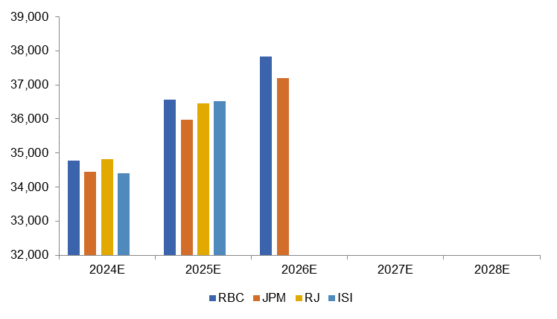
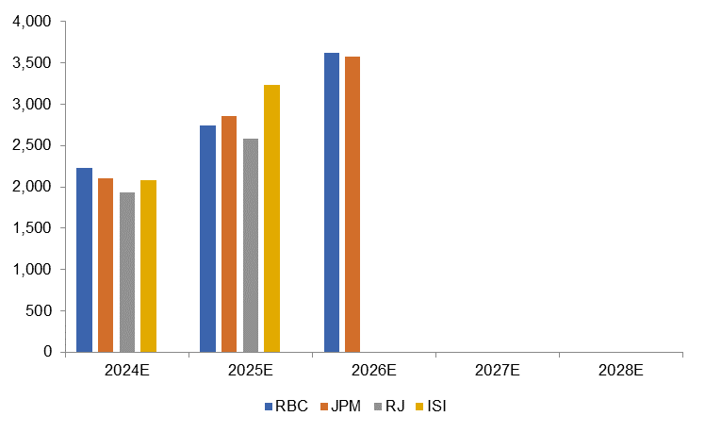
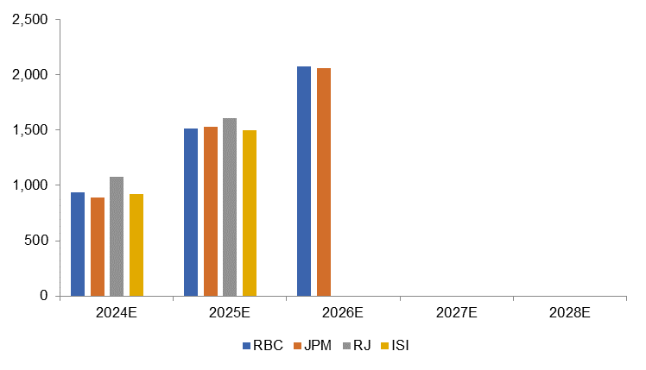
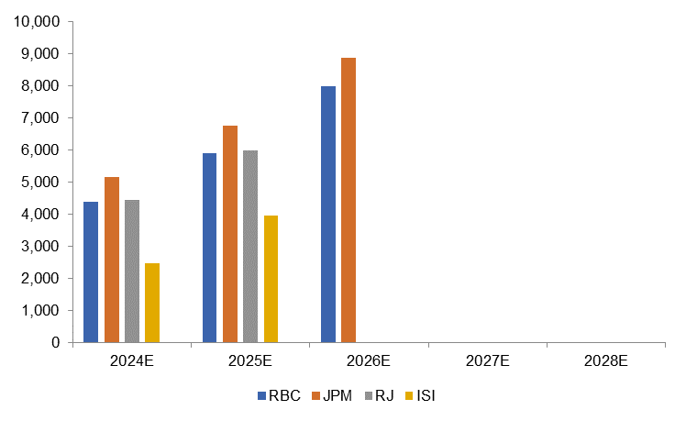
Forecast Comparison: Lack of Depth From Street
Most Street projections are 1 to 2 years out, FMR modeling out to 2028
GEV Revenue
GEV EBITDA
FMR Analyst Models
FMR Analyst Models
GEV FCF
Net Cash
FMR Analyst Models
FMR Analyst Models
Source: Bloomberg, Fidelity Investments
Notes:
OPTIONAL
------------
Admin note: Product Annual Review

Slide 14
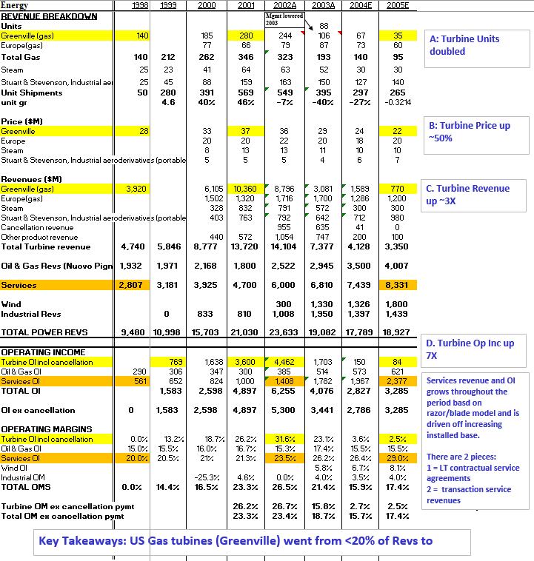
GE Power Margin Cycle 20 Years Ago
For illustrative purposes only
Source: Fidelity Investments. The stocks mentioned are not necessarily holdings invested in by Fidelity. References to specific company stocks should not be construed as recommendations or investment advice. The statements and opinions are those of the speaker, do not necessarily represent the views of Fidelity as a whole, and are subject to change at any time, based on market or other conditions.
Notes:
OPTIONAL
------------
Admin note: Product Annual Review

Slide 15
GE Power Operating Margin Journey
Part 1: Gas Turbine Boom
1: Gas turbine cycle
Source: Fidelity Investments, FactSet.
The stocks mentioned are not necessarily holdings invested in by Fidelity. References to specific company stocks should not be construed as recommendations or investment advice. The statements and opinions are those of the speaker, do not necessarily represent the views of Fidelity as a whole, and are subject to change at any time, based on market or other conditions.
Notes:
OPTIONAL
------------
Admin note: Product Annual Review

Slide 16
GE Power Operating Margin Journey
Part 2: The Decline
Acquired European factories and labor that were high cost and difficult to restructure.
Key Takeaway: GE Power was a high margin, cash generative, high ROIC business for decades before the Alstom Acquisition debacle.
Source: Fidelity Investments, FactSet.
The stocks mentioned are not necessarily holdings invested in by Fidelity. References to specific company stocks should not be construed as recommendations or investment advice. The statements and opinions are those of the speaker, do not necessarily represent the views of Fidelity as a whole, and are subject to change at any time, based on market or other conditions.
Notes:
OPTIONAL
------------
Admin note: Product Annual Review

Slide 17
Recency Bias Impacting Street’s Power Estimates
FMR Analyst Models
FMR Analyst Models
Historical GE Power Margins:
'98-'16 Avg: 19%
'98-'16 ex '00-'03: 18%
Source: Bloomberg and Fidelity Investments
The stocks mentioned are not necessarily holdings invested in by Fidelity. References to specific company stocks should not be construed as recommendations or investment advice. The statements and opinions are those of the speaker, do not necessarily represent the views of Fidelity as a whole, and are subject to change at any time, based on market or other conditions.
Notes:
OPTIONAL
------------
Admin note: Product Annual Review

Slide 18
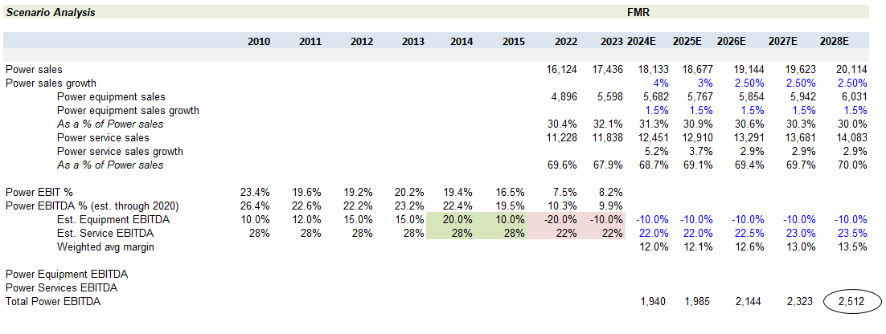
Deep Dive Into Power Assumptions
Portfolio manager leverages own expertise and FMR research to arrive at conclusion
FMR models each line item out to 2028
2/29/20 QN on additional comments on Dinner with CEO Larry Culp
Remaining questions post dinner:
Power transactional services was a $2-$2.5B OI business in 2016-2017. Estimate today $500M. To deliver Alstom “synergies” GE fired salespeople on the factory floor. Sounded like plan to increase visibility/sales coverage into these turbines (GE didn’t know where majority of these were several years after firing salespeople) hasn’t led to incremental revenues/margins. Wonder now if GE’s retrenchment opened the door to lower cost 3rd party parts solutions. This would be an incremental negative to ultimate LT power OM story (still long way to go before this matters though)
2016 Alstom acquisition created high-cost overcapacity in Europe
GE has been restructuring since to reduce fixed costs on the OE side.
In addition, the power service margins have been dragged down from transactional service OI evaporating.
Source: Fidelity Investments
The stocks mentioned are not necessarily holdings invested in by Fidelity. References to specific company stocks should not be construed as recommendations or investment advice. The statements and opinions are those of the speaker, do not necessarily represent the views of Fidelity as a whole, and are subject to change at any time, based on market or other conditions.
Notes:
OPTIONAL
------------
Admin note: Product Annual Review

Slide 19
Power Demand: Appears to be Accelerating on the back of AI, Data Centers, Electrification & Population Movement
Source: IEA, Fidelity Investments
Notes:
OPTIONAL
------------
Admin note: Product Annual Review

Slide 20
Power Supply & Demand: PJM Diminishing Baseload Capacity
Result of PJM Demand > Supply
Source: S&P, Fidelity Investments
The stocks mentioned are not necessarily holdings invested in by Fidelity. References to specific company stocks should not be construed as recommendations or investment advice. The statements and opinions are those of the speaker, do not necessarily represent the views of Fidelity as a whole, and are subject to change at any time, based on market or other conditions
Notes:
OPTIONAL
------------
Admin note: Product Annual Review

Slide 21
Portfolio Characteristics and Performance
Notes:
This divider slide is OPTIONAL

Slide 22
Sector Weights
As of March 31, 2026
 | 3/31/26 | 3/31/25
 | Active Weight | Active Weight
 | 8.6% | 9.2%
 | 6.0% | 5.7%
 | 0.3% | 1.1%
 | 0.0% | -1.7%
 | -0.3% | 2.6%
 | -0.7% | 0.4%
 | -0.7% | -0.5%
 | -1.4% | -1.4%
 | -1.7% | -1.2%
 | -4.3% | -7.2%
 | -9.9% | -9.6%
The top industry sectors are presented to illustrate examples of the industries in which the fund may invest, and may not be representative of the fund’s current or future investments. They should not be construed or used as a recommendation for any sector. The sector weights shown here are based on the Global Industry Classification Standard (GICS). The GICS classifications aim to enhance the investment research and asset management process for financial professionals worldwide. The GICS is the result of numerous discussions with asset owners, portfolio managers, and investment analysts around the world and is designed to respond to the global financial community's need for an accurate, complete, and standard industry definition. Active weight represents the percentage of equity assets in the fund relative to the benchmark; a positive number represents an overweight and a negative number is an underweight.
Source: Fidelity Investments.
Notes:
OPTIONAL
------------
Admin note: IPA Quarterly Update

Slide 23
Top 10 Holdings
As of March 31, 2026
As of 3/31/26 | Sector |  | As of 3/31/25 | Sector
NVIDIA Corp. | Information Technology |  | Wells Fargo & Co. | Financials
Microsoft Corp. | Information Technology |  | Microsoft Corp. | Information Technology
The Boeing Co. | Industrials |  | GE Aerospace | Industrials
Exxon Mobil Corp. | Energy |  | Exxon Mobil Corp. | Energy
Wells Fargo & Co. | Financials |  | NVIDIA Corp. | Information Technology
GE Aerospace | Industrials |  | The Boeing Co. | Industrials
GE Vernova, Inc. | Industrials |  | Meta Platforms, Inc. Class A | Communication Services
Alphabet, Inc. Class A | Communication Services |  | GE Vernova, Inc. | Industrials
Apple, Inc. | Information Technology |  | Bank of America Corp. | Financials
Amazon.com, Inc. | Consumer Discretionary |  | Apple, Inc. | Information Technology
Top 10 Holdings as % of Net Assets: Total Number of Holdings: Foreign Holdings: |  |  | Top 10 Holdings as % of Net Assets: Total Number of Holdings: Foreign Holdings:
42.2%
42.5%
195
173
12.8%
13.0%
The top 10 holdings are presented to illustrate examples of the holdings in which the fund may invest, and may not be representative of the fund's current or future investments. Holdings do not include money market investments or futures contracts.
Source: Fidelity Investments.
Notes:
REQUIRED
------------
Admin note: IPA Quarterly Update

Slide 24
Active Weights
As of March 31, 2026
Five Largest Active Overweights |  |  |  | Five Largest Active Underweights
Security Name | Sector | Active Weight |  | Security Name | Sector | Active Weight
The Boeing Co. | Industrials | 4.26 |  | Apple, Inc. | Information Technology | -3.62
Wells Fargo & Co. | Financials | 3.71 |  | Tesla, Inc. | Consumer Discretionary | -1.87
GE Vernova, Inc. | Industrials | 3.51 |  | Berkshire Hathaway, Inc. Class B | Financials | -1.57
GE Aerospace | Industrials | 3.41 |  | JPMorgan Chase & Co. | Financials | -1.42
Exxon Mobil Corp. | Energy | 3.17 |  | Walmart, Inc. | Consumer Staples | -0.97
Active weight represents the percentage of equity assets in the fund relative to the benchmark; a positive number represents an overweight and a negative number is an underweight. Benchmark is S&P 500 Index.
Source: Fidelity Investments.
Notes:
OPTIONAL
------------
Admin note: IPA Quarterly Update

Slide 25
Portfolio Characteristics Aligned with Investment Philosophy
1. GROWTH
2. VALUATION
EPS Growth 1-Year (IBES Forecast)
Fund | Index*
21.8% | 22.4%
P/E (IBES 1-Year Forecast)
Fund | Index*
19.5 | 20.2
FIDELITY LARGE CAP
STOCK
Differentiated long term view drives low turnover: 20%** Annualized turnover rate
Weighted Avg. Market Cap ($B)
Fund | Index*
1,090.0 | 1,223.0
3. PATIENCE
4. MARKET CAP
* Index refers to the S&P 500 Index.
** Annualized turnover as. of 10/31/25.
See the Glossary at the end of this presentation for more information on any terms.
Source: Fidelity Investments, as of 3/31/26.
Notes:
OPTIONAL
------------
Admin note: IPA Quarterly Update

Slide 26
Differentiated Intersection of Portfolio Characteristics
Overarching philosophy and mandate combine to result in a compelling intersection of investment characteristics
VALUATION | SIZE | TECHNOLOGY & INTERNET MARKETING
8% of peers with all 3 characteristics
Fidelity Large Cap Stock Fund | Price-to-earnings ratio < 24.0x | Average Market Cap > $325B | Technology Sector Exposure < 23.0% & Internet Software & Services= 0.0%
% of Mutual Funds*: (Total: 652 Morningstar US Fund Large Blend funds) | 16.3% | 53.8% | 14.9%
* Percentages represent the percent of Morningstar US Fund Large Blend (Oldest Share Class) peers that adhere to the characteristic parameters in each column.
Note: In April 2023, Fidelity Large Cap Stock Fund was reclassified as Morningstar US Fund Large Blend from Morningstar US Fund Large Value.
Source: Morningstar, as of 12/31/25.
Notes:
OPTIONAL
------------
Admin note: IPA Annual Update
Data is often lagged. Depending on timing of deck request it can either be updated for Q4 or Q1.

Slide 27
Portfolio Characteristics
As of March 31, 2026
MARKET CAPITALIZATION
Fund Facts | Fidelity Large Cap Stock Fund | S&P 500 Index
Total Net Assets ($B) | $9.2 | -
Number of Holdings | 195 | -
Turnover Rate* (10/25) | 20% | -
Asset Allocation
Domestic Equities | 83.2% | -
International Equities | 12.8% | -
Developed Markets | 12.0% | -
Emerging Markets | 0.8% | -
Bonds | 0.0% | -
Cash and Other | 4.0% | -
Valuation
P/E (Trailing) | 25.6x | 25.0x
P/E (IBES 1-Year Forecast) | 19.5x | 20.2x
P/Book | 4.2x | 5.1x
Price/Cash Flow | 20.8x | 19.9x
ROE (5-Year Trailing) | 16.2% | 19.9%
Growth
Sales Growth/Share 1-Year (Trailing) | 13.6% | 14.0%
EPS Growth 1-Year (Trailing) | 39.5% | 15.5%
EPS Growth 1-Year (IBES Forecast) | 21.8% | 22.4%
EPS Growth 5-Year (Trailing) | 23.6% | 21.0%
Size
Weighted Average Market Cap ($B) | 1,090.0 | 1,223.0
Weighted Median Market Cap ($B) | 264.6 | 331.6
Median Market Cap ($B) | 56.7 | 39.9
* Turnover Rate is from the fund’s latest annual or semiannual report. If from the former, it represents annual full fiscal year activity. If from the latter, it is an annualized number based on a half-year of trading data.
See the Glossary at the end of this presentation for more information on any terms.
Source: Fidelity Investments.
Notes:
OPTIONAL
------------
Admin note: IPA Quarterly Update

Slide 28
Performance
As of March 31, 2026
Average Annual Total Returns (%) | Cumulative 3-Month | Cumulative YTD | 1-Year | 3-Year | 5-Year | 10-Year | Since Inception¹
Fidelity Large Cap Stock Fund | -1.90 | -1.90 | 28.09 | 22.36 | 15.06 | 15.18 | 10.17
S&P 500 Index | -4.33 | -4.33 | 17.80 | 18.32 | 12.06 | 14.16 | --
Morningstar US Fund Large Blend Category Average (# of Funds Count) | -3.86 (--) | -3.86 (--) | 15.66 (1,312) | 16.19 (1,212) | 10.29 (1,122) | 12.77 (886) | –
Morningstar US Fund Large Blend % Rank in Category | -- | -- | 3 | 3 | 2 | 3 | –
Gross Expense Ratio (as of 6/28/25) | 0.75%
¹ Inception date is 6/22/95.
Morningstar Averages represent the average return of all funds within their respective mutual fund investment category. The number of funds in each category periodically changes. The ranks for Fidelity Large Cap Stock Fund were based on the Morningstar US Fund Large Blend Category Average. Morningstar Total Percentile Rank is calculated using Morningstar’s total return database. The calculation of total return is determined each month by taking the change in monthly net asset value, reinvesting all income and capital gains distributions during that month, and dividing by the starting NAV. Reinvestments are made using the actual reinvestment NAV, and daily payoffs are reinvested monthly. Multiple share classes of a fund have a common portfolio but impose different expense structures.
Performance data shown represents past performance and is no guarantee of future results. Investment return and principal value of an investment will fluctuate; therefore, you may have a gain or loss when you sell your shares. Current performance may be higher or lower than that quoted. To learn more or to obtain the most recent month-end or other share-class performance, visit fidelity.com, institutional.fidelity.com, or 401k.com.
It is not possible to invest directly in an index. All market indices are unmanaged. Index performance is not meant to represent that of any Fidelity mutual fund.
Gross Expense Ratio/Expense Ratio before reductions is the total annual class operating expense ratio from the most recent prospectus and generally is based on amounts incurred during the most recent fiscal year.
Source: Fidelity Investments and Morningstar.
Notes:
REQUIRED Classes may be removed as appropriate.
------------
Admin note: IPA Quarterly Update

Slide 29
Calendar Year Returns
Calendar Year Returns (%) | 2025 | 2024 | 2023 | 2022 | 2021 | 2020
Fidelity Large Cap Stock Fund | 27.57 | 26.28 | 23.52 | -7.95 | 25.83 | 9.00
S&P 500 Index | 17.88 | 25.02 | 26.29 | -18.11 | 28.71 | 18.40
Morningstar US Fund Large Blend Category Average | 15.54 | 21.45 | 22.32 | -16.96 | 26.07 | 15.83
3-Year Risk/Return Statistics | Fidelity Large Cap Stock Fund
Historical Beta | 0.95
R² | 0.90
Historical Tracking Error | 3.85
Information Ratio | 1.05
Performance data shown represents past performance and is no guarantee of future results. Investment return and principal value of an investment will fluctuate; therefore, you may have a gain or loss when you sell your shares. Current performance may be higher or lower than that quoted. To learn more or to obtain the most recent month-end or other share-class performance, visit fidelity.com, institutional.fidelity.com, or 401k.com.
It is not possible to invest directly in an index. All market indices are unmanaged. Index performance is not meant to represent that of any Fidelity mutual fund.
See the Glossary at the end of this presentation for more information on any terms.
Source: Fidelity Investments and Morningstar, as of 3/31/26.
Notes:
REQUIRED Classes may be removed as appropriate.
------------
Admin note: IPA Quarterly Update

Slide 30
Performance
As of March 31, 2026
Average Annual Total Returns (%) | Cumulative 3-Month | Cumulative YTD | 1-Year | 3-Year | 5-Year | 10-Year | Since Inception¹
FA Large Cap Stock Fund—CL A† (NAV) | -1.97 | -1.97 | 27.94 | 22.31 | 15.03 | 15.16 | 10.17
FA Large Cap Stock Fund—CL A† (POP) | -7.61 | -7.61 | 20.58 | 19.92 | 13.67 | 14.48 | 9.96
FA Large Cap Stock Fund—CL I† | -1.91 | -1.91 | 28.05 | 22.35 | 15.05 | 15.17 | 10.17
S&P 500 Index | -4.33 | -4.33 | 17.80 | 18.32 | 12.06 | 14.16 | --
Morningstar US Fund Large Blend Category Average (# of Funds Count) | -3.86 (--) | -3.86 (--) | 15.66 (1,312) | 16.19 (1,212) | 10.29 (1,122) | 12.77 (886) | –
Morningstar US Fund Large Blend % Rank in Category—CL A | -- | -- | 4* | 3* | 2* | 6* | –
Morningstar US Fund Large Blend % Rank in Category—CL I | -- | -- | 3* | 3* | 2* | 3* | –
Gross Expense Ratio—CL A (as of 11/13/25) | 1.02%
Gross Expense Ratio—CL I (as of 11/13/25) | 0.77%
¹ Inception date is 6/22/95.
Fidelity launched new Advisor share classes of the Fidelity Large Cap Stock Fund on 11/18/25. Shares of the previously separate Fidelity Advisor Large Cap Fund were merged into the newly created and corresponding classes of the Fidelity Large Cap Stock Fund. All share classes now share the same portfolio.
† Initial offering of Class A and I took place on 9/11/25. Returns and Yields prior to 11/13/25 are those of Fidelity® Large Cap Stock Fund retail share class.
* Morningstar Total Percentile Rank for these periods are sourced from Morningstar and are based on share class extended performance returns as calculated by Morningstar’s total return database.
Morningstar Averages represent the average return of all funds within their respective mutual fund investment category. The number of funds in each category periodically changes. The ranks for FA Large Cap Stock Fund were based on the Morningstar US Fund Large Blend Category Average. Morningstar Total Percentile Rank is calculated using Morningstar’s total return database. The calculation of total return is determined each month by taking the change in monthly net asset value, reinvesting all income and capital gains distributions during that month, and dividing by the starting NAV. Reinvestments are made using the actual reinvestment NAV, and daily payoffs are reinvested monthly. Multiple share classes of a fund have a common portfolio but impose different expense structures.
Performance data shown represents past performance and is no guarantee of future results. Investment return and principal value of an investment will fluctuate; therefore, you may have a gain or loss when you sell your shares. Current performance may be higher or lower than that quoted. To learn more or to obtain the most recent month-end or other share-class performance, visit fidelity.com, institutional.fidelity.com, or 401k.com.
It is not possible to invest directly in an index. All market indices are unmanaged. Index performance is not meant to represent that of any Fidelity mutual fund.
Gross Expense Ratio/Expense Ratio before reductions is the total annual class operating expense ratio from the most recent prospectus and generally is based on amounts incurred during the most recent fiscal year.
Class A shares have a maximum front-end sales charge of 5.75% and a 12b-1 fee. POP (public offering price) returns include the effects of each class’ maximum sales charge, if any. NAV (net asset value) returns do not.
Class I is available only to eligible investors as described in the fund’s prospectus.
Source: Fidelity Investments and Morningstar.
For institutional use only.
Notes:
REQUIRED. If using Z share performance this slide is OPTIONAL. Classes may be removed as appropriate.
------------
Admin note: IPA Quarterly Update

Slide 31
Calendar Year Returns
FA Large Cap Stock Fund
Calendar Year Returns (%) | 2025 | 2024 | 2023 | 2022 | 2021 | 2020
FA Large Cap Fund—CL A† (NAV) | 27.52 | 26.28 | 23.52 | -7.95 | 25.83 | 9.00
FA Large Cap Fund—CL A† (POP) | 20.18 | 19.02 | 16.41 | -13.24 | 18.60 | 2.73
FA Large Cap Fund—CL I† | 27.55 | 26.28 | 23.52 | -7.95 | 25.83 | 9.00
S&P 500 Index | 17.88 | 25.02 | 26.29 | -18.11 | 28.71 | 18.40
Morningstar US Fund Large Blend Category Average | 15.54 | 21.45 | 22.32 | -16.96 | 26.07 | 15.83
3-Year Risk/Return Statistics | Class A† | Class I†
Historical Beta | 0.95 | 0.95
R² | 0.90 | 0.90
Historical Tracking Error | 3.85 | 3.85
Information Ratio | 1.04 | 1.05
Fidelity launched new Advisor share classes of the Fidelity Large Cap Stock Fund on 11/18/25. Shares of the previously separate Fidelity Advisor Large Cap Fund were merged into the newly created and corresponding classes of the Fidelity Large Cap Stock Fund. All share classes now share the same portfolio.
† Initial offering of Class A and I took place on 9/11/25. Returns and Yields prior to 11/13/25 are those of Fidelity® Large Cap Stock Fund retail share class.
Performance data shown represents past performance and is no guarantee of future results. Investment return and principal value of an investment will fluctuate; therefore, you may have a gain or loss when you sell your shares. Current performance may be higher or lower than that quoted. To learn more or to obtain the most recent month-end or other share-class performance, visit fidelity.com, institutional.fidelity.com, or 401k.com.
It is not possible to invest directly in an index. All market indices are unmanaged. Index performance is not meant to represent that of any Fidelity mutual fund.
Class A shares have a maximum front-end sales charge of 5.75% and a 12b-1 fee. POP (public offering price) returns include the effects of each class’ maximum sales charge, if any. NAV (net asset value) returns do not.
Class I is available only to eligible investors as described in the fund’s prospectus.
See the Glossary at the end of this presentation for more information on any terms.
Source: Fidelity Investments and Morningstar, as of 3/31/26.
Notes:
REQUIRED. If using Z share performance this slide is OPTIONAL. Classes may be removed as appropriate.
------------
Admin note: IPA Quarterly Update

Slide 32
Performance
As of March 31, 2026
Average Annual Total Returns (%) | Cumulative 3-Month | Cumulative YTD | 1-Year | 3-Year | 5-Year | 10-Year | Since Inception¹
FA Large Cap Stock Fund—CL Z† (NAV) | -1.88 | -1.88 | 28.10 | 22.37 | 15.06 | 15.18 | 10.17
S&P 500 Index | -4.33 | -4.33 | 17.80 | 18.32 | 12.06 | 14.16 | --
Morningstar US Fund Large Blend Category Average (# of Funds Count) | -3.86 (--) | -3.86 (--) | 15.66 (1,312) | 16.19 (1,212) | 10.29 (1,122) | 12.77 (886) | –
Morningstar US Fund Large Blend % Rank in Category—CL Z | -- | -- | 3* | 3* | 2* | 3* | –
Gross Expense Ratio—CL Z† (as of 11/13/25) | 0.66%
¹ Inception date is 6/22/95.
Fidelity launched new Advisor share classes of the Fidelity Large Cap Stock Fund on 11/18/25. Shares of the previously separate Fidelity Advisor Large Cap Fund were merged into the newly created and corresponding classes of the Fidelity Large Cap Stock Fund. All share classes now share the same portfolio.
† Initial offering of Class Z took place on 9/11/25. Returns and Yields prior to 11/13/25 are those of Fidelity® Large Cap Stock Fund retail share class.
* Morningstar Total Percentile Rank for these periods are sourced from Morningstar and are based on share class extended performance returns as calculated by Morningstar’s total return database.
Morningstar Averages represent the average return of all funds within their respective mutual fund investment category. The number of funds in each category periodically changes. The ranks for FA Large Cap Stock Fund were based on the Morningstar US Fund Large Blend Category Average. Morningstar Total Percentile Rank is calculated using Morningstar’s total return database. The calculation of total return is determined each month by taking the change in monthly net asset value, reinvesting all income and capital gains distributions during that month, and dividing by the starting NAV. Reinvestments are made using the actual reinvestment NAV, and daily payoffs are reinvested monthly. Multiple share classes of a fund have a common portfolio but impose different expense structures.
Performance data shown represents past performance and is no guarantee of future results. Investment return and principal value of an investment will fluctuate; therefore, you may have a gain or loss when you sell your shares. Current performance may be higher or lower than that quoted. To learn more or to obtain the most recent month-end or other share-class performance, visit fidelity.com, institutional.fidelity.com, or 401k.com.
It is not possible to invest directly in an index. All market indices are unmanaged. Index performance is not meant to represent that of any Fidelity mutual fund.
Gross Expense Ratio/Expense Ratio before reductions is the total annual class operating expense ratio from the most recent prospectus and generally is based on amounts incurred during the most recent fiscal year.
Class Z is available only to eligible investors as described in the fund’s prospectus.
Source: Fidelity Investments and Morningstar.
For institutional use only.
Notes:
OPTIONAL– delete if Z shares are not applicable (Class Z is available only in eligible employer-sponsored retirement plans and fee-based programs.) Classes may be removed as appropriate.
------------
Admin note: IPA Quarterly Update

Slide 33
Calendar Year Returns
Calendar Year Returns (%) | 2025 | 2024 | 2023 | 2022 | 2021 | 2020
FA Large Cap Stock Fund—CL Z† | 27.56 | 26.28 | 23.52 | -7.95 | 25.83 | 9.00
S&P 500 Index | 17.88 | 25.02 | 26.29 | -18.11 | 28.71 | 18.40
Morningstar US Fund Large Blend Category Average | 15.54 | 21.45 | 22.32 | -16.96 | 26.07 | 15.83
3-Year Risk/Return Statistics | FA Large Cap Stock Fund- Class Z†
Historical Beta | 0.95
R² | 0.90
Historical Tracking Error | 3.86
Information Ratio | 1.05
Fidelity launched new Advisor share classes of the Fidelity Large Cap Stock Fund on 11/18/25. Shares of the previously separate Fidelity Advisor Large Cap Fund were merged into the newly created and corresponding classes of the Fidelity Large Cap Stock Fund. All share classes now share the same portfolio.
† Initial offering of Class Z took place on 9/11/25. Returns and Yields prior to 11/13/25 are those of Fidelity® Large Cap Stock Fund retail share class.
Performance data shown represents past performance and is no guarantee of future results. Investment return and principal value of an investment will fluctuate; therefore, you may have a gain or loss when you sell your shares. Current performance may be higher or lower than that quoted. To learn more or to obtain the most recent month-end or other share-class performance, visit fidelity.com, institutional.fidelity.com, or 401k.com.
It is not possible to invest directly in an index. All market indices are unmanaged. Index performance is not meant to represent that of any Fidelity mutual fund.
See the Glossary at the end of this presentation for more information on any terms.
Source: Fidelity Investments and Morningstar, as of 3/31/26.
Notes:
OPTIONAL– delete if Z shares are not applicable (Class Z is available only in eligible employer-sponsored retirement plans and fee-based programs.) Classes may be removed as appropriate.
------------
Admin note: IPA Quarterly Update

Slide 34
Cumulative Performance Attribution: Trailing 12 Months
By sector, April 1, 2025–March 31, 2026
Beginning Relative Weight (%) | 9.2 | 5.7 | 2.6 | -9.7 | -0.5 | -7.2 | 1.2 | 0.4 | -1.6 | -1.4 | -1.3
Ending Relative Weight (%) | 8.6 | 6.0 | -0.3 | -10.0 | -0.7 | -4.2 | 0.3 | -0.7 | 0.0 | -1.4 | -1.7
Asset Class | Value Added | Cash | Other Investments | Net Expenses | Total Contribution
Relative Contribution (bps) | 1,177 | -64 | 4 | -92 | 1,025
The sector positioning is presented to illustrate examples of the sectors in which the fund may invest, and may not be representative of the fund's current or future investments. Mention of these sectors should not be construed as a recommendation. The fund and benchmark returns are calculated by Fidelity Performance Attribution and constructed from the underlying security-level data; these returns may not tie to standard, published performance information. Cumulative total (actual) returns are calculated based on total fund assets and reflect the composite return of the fund, which may not necessarily reflect a particular class' return. Expenses are the total fund expenses for all classes in the fund, as applicable, and do not represent a particular class’ expenses. The returns are net of expenses and include 12b-1 fees (if any), but do not include sales loads for applicable Advisor classes. The sector weights shown here are based on the Global Industry Classification Standard (GICS).
Performance data shown represents past performance and is no guarantee of future results. Investment return and principal value of an investment will fluctuate; therefore, you may have a gain or loss when you sell your shares. Current performance may be higher or lower than that quoted.
Source: Fidelity Investments.
Notes:
OPTIONAL
------------
Admin note: IPA Quarterly Update

Slide 35
Top 5 Contributors and Detractors: Trailing 12 Months
April 1, 2025–March 31, 2026
Top 5 Contributors |  |  |  |  | Top 5 Detractors
Company | Sector | Avg. Active Weight | Contribution to Rel. Return (bps) |  | Company | Sector | Avg. Active Weight | Contribution to Rel. Return (bps)
GE Vernova, Inc. | Industrials | 3.65 | 393 |  | SAP SE sponsored ADR | Information Technology | 0.86 | -53
GE Aerospace | Industrials | 4.35 | 124 |  | UnitedHealth Group, Inc. | Health Care | 0.61 | -50
Imperial Oil Ltd. | Energy | 1.47 | 94 |  | Boston Scientific Corp. | Health Care | 0.74 | -49
First Quantum Materials Ltd. | Materials | 1.17 | 78 |  | Tesla, Inc. | Consumer Discretionary | -1.91 | -41
Exxon Mobil Corp. | Energy | 3.02 | 76 |  | Comcast Corp. Class A | Communication Services | 0.74 | -35
While this review mainly outlines drivers for the year, our buy and sell decisions are typically based on the longer-term prospects for stocks and not on short time periods.
Performance data shown represents past performance and is no guarantee of future results. Investment return and principal value of an investment will fluctuate; therefore, you may have a gain or loss when you sell your shares. Current performance may be higher or lower than that quoted.
Source: Fidelity Investments.
Notes:
OPTIONAL
------------
Admin note: IPA Quarterly Update

Slide 36
Annualized Performance Attribution: Trailing 3 Years
By sector, April 1, 2023–March 31, 2026
Beginning Relative Weight (%) | 7.2 | 4.0 | -0.5 | 7.7 | -2.2 | -1.8 | 0.5 | -6.3 | -2.9 | -10.0 | 0.5
Ending Relative Weight (%) | 8.6 | -0.3 | 0.3 | 6.0 | -1.7 | -1.4 | -0.7 | -4.2 | 0.0 | -10.0 | -0.7
Asset Class | Value Added | Cash | Other Investments | Net Expenses | Total Contribution
Relative Contribution (bps) | 551 | -57 | 4 | -94 | 404
The sector positioning is presented to illustrate examples of the sectors in which the fund may invest, and may not be representative of the fund's current or future investments. Mention of these sectors should not be construed as a recommendation. The fund and benchmark returns are calculated by Fidelity Performance Attribution and constructed from the underlying security-level data; these returns may not tie to standard, published performance information. Cumulative total (actual) returns are calculated based on total fund assets and reflect the composite return of the fund, which may not necessarily reflect a particular class' return. Expenses are the total fund expenses for all classes in the fund, as applicable, and do not represent a particular class’ expenses. The returns are net of expenses and include 12b-1 fees (if any), but do not include sales loads for applicable Advisor classes. The sector weights shown here are based on the Global Industry Classification Standard (GICS).
Performance data shown represents past performance and is no guarantee of future results. Investment return and principal value of an investment will fluctuate; therefore, you may have a gain or loss when you sell your shares. Current performance may be higher or lower than that quoted.
Source: Fidelity Investments.
Notes:
OPTIONAL
------------
Admin note: IPA Quarterly Update

Slide 37
Top 5 Contributors and Detractors: Trailing 3 Years
April 1, 2023–March 31, 2026
Top 5 Contributors |  |  |  |  | Top 5 Detractors
Company | Sector | Avg. Active Weight | Contribution to Rel. Return (bps) |  | Company | Sector | Avg. Active Weight | Contribution to Rel. Return (bps)
GE Aerospace | Industrials | 5.13 | 797 |  | NVIDIA Corp. | Information Technology | -1.32 | -363
GE Vernova, Inc. | Industrials | 1.92 | 782 |  | The Boeing Co. | Industrials | 2.80 | -166
Wells Fargo & Co. | Financials | 5.12 | 338 |  | United Parcel Service, Inc. Class B | Industrials | 0.83 | -140
Vertiv Holdings Co. | Industrials | 0.58 | 238 |  | Broadcom, Inc. | Information Technology | -0.62 | -123
Imperial Oil Ltd. | Energy | 1.11 | 151 |  | Comcast Corp. Class A | Communication Services | 1.12 | -112
While this review mainly outlines drivers for the trailing three years, our buy and sell decisions are typically based on the longer-term prospects for stocks and not on short time periods.
Performance data shown represents past performance and is no guarantee of future results. Investment return and principal value of an investment will fluctuate; therefore, you may have a gain or loss when you sell your shares. Current performance may be higher or lower than that quoted.
Source: Fidelity Investments.
Notes:
OPTIONAL
------------
Admin note: IPA Quarterly Update

Slide 38
Annualized Performance Attribution: Trailing 5 Years
By sector, April 1, 2021–March 31, 2026
Beginning Relative Weight (%) | 7.2 | 5.3 | 1.5 | -6.1 | 5.8 | -1.7 | -0.2 | -2.3 | -0.3 | -2.4 | -7.8
Ending Relative Weight (%) | 8.6 | 6.0 | 0.3 | -4.2 | -0.3 | -1.4 | -0.7 | -1.7 | 0.0 | -0.7 | -10.0
Asset Class | Value Added | Cash | Other Investments | Net Expenses | Total Contribution
Relative Contribution (bps) | 407 | -31 | 4 | -82 | 298
The sector positioning is presented to illustrate examples of the sectors in which the fund may invest, and may not be representative of the fund's current or future investments. Mention of these sectors should not be construed as a recommendation. The fund and benchmark returns are calculated by Fidelity Performance Attribution and constructed from the underlying security-level data; these returns may not tie to standard, published performance information. Cumulative total (actual) returns are calculated based on total fund assets and reflect the composite return of the fund, which may not necessarily reflect a particular class' return. Expenses are the total fund expenses for all classes in the fund, as applicable, and do not represent a particular class’ expenses. The returns are net of expenses and include 12b-1 fees (if any), but do not include sales loads for applicable Advisor classes. The sector weights shown here are based on the Global Industry Classification Standard (GICS).
Performance data shown represents past performance and is no guarantee of future results. Investment return and principal value of an investment will fluctuate; therefore, you may have a gain or loss when you sell your shares. Current performance may be higher or lower than that quoted.
Source: Fidelity Investments.
Notes:
OPTIONAL
------------
Admin note: IPA Quarterly Update

Slide 39
Top 5 Contributors and Detractors: Trailing 5 Years
April 1, 2021–March 31, 2026
Top 5 Contributors |  |  |  |  | Top 5 Detractors
Company | Sector | Avg. Active Weight | Contribution to Rel. Return (bps) |  | Company | Sector | Avg. Active Weight | Contribution to Rel. Return (bps)
GE Aerospace | Industrials | 5.44 | 943 |  | NVIDIA Corp. | Information Technology | -1.34 | -552
GE Vernova, Inc. | Industrials | 1.15 | 848 |  | Comcast Corp. Class A | Communication Services | 1.48 | -276
Exxon Mobil Corp. | Energy | 4.55 | 604 |  | The Boeing Co. | Industrials | 2.14 | -180
Wells Fargo & Co. | Financials | 4.93 | 320 |  | Broadcom, Inc. | Information Technology | -0.62 | -173
Vertiv Holdings Co. | Industrials | 0.55 | 225 |  | United Parcel Service, Inc. Class B | Industrials | 1.04 | -116
While this review mainly outlines drivers for the trailing five years, our buy and sell decisions are typically based on the longer-term prospects for stocks and not on short time periods.
Performance data shown represents past performance and is no guarantee of future results. Investment return and principal value of an investment will fluctuate; therefore, you may have a gain or loss when you sell your shares. Current performance may be higher or lower than that quoted.
Source: Fidelity Investments.
Notes:
OPTIONAL
------------
Admin note: IPA Quarterly Update

Slide 40
Appendix
Notes:
This divider slide is OPTIONAL

Slide 41
Portfolio Manager Profile: Matt Fruhan, CFA
Current Responsibilities |  | Previous Responsibilities |  | Tenure |  | Education
Fidelity Large Cap Stock Fund (FA) 2005–Present Fidelity Mega Cap Stock Fund (FA) 2009–Present Fidelity Growth & Income Portfolio (FA & VIP) 2011–Present Fidelity Series Growth & Income Portfolio (FA) 2012–Present FIAM Large Cap Stock 2013–Present FIAM US Equity 2013–Present Fidelity Advisor Capital Development Fund 2013–Present Fidelity Equity Income Strategy (SMA) 2017–Present |  | Fidelity Select & Sector Funds 1999–2005 Fidelity Equity Analyst 1999–2005 Fidelity High Yield Associate 1995–1997 |  | Fidelity Investments Since 1995 |  | CFA Charterholder Harvard Business School MBA, 1999 Harvard University BA, 1995
OVER 30 YEARS of asset management experience
Source: Fidelity Investments.
Notes:
OPTIONAL
------------
Admin note: Product Annual Review

Slide 42
Institutional Portfolio Manager Profile: Naveed Rahman
Current Responsibilities (2012–Present) |  | Previous Responsibilities |  | Tenure |  | Education
Portfolio Manager Fidelity Equity Income Strategy (SMA) Institutional Portfolio Manager Fidelity Low-Priced Stock Fund (FA, CIT) Fidelity Growth & Income Portfolio (FA, VIP) Fidelity Large Cap Stock Fund (FA) Fidelity Equity-Income Fund (FA, VIP) Fidelity Equity-Dividend Income Fund Fidelity Stock Selector Large Value Fund (FA) Fidelity Value Discovery Fund (FA Equity Value Fund) Fidelity Blue Chip Value Fund & ETF (FA Value Leaders Fund) Fidelity Value Fund (FA, VIP) Fidelity Value Strategies (FA, VIP) |  | VP—Equity Investment Product Strategy and Development 2005–2011 Prior to Fidelity Boston Consulting Group 1996–2002 |  | Fidelity Investments Since 2003 Industry Experience Since 1996 |  | Stanford University MBA, 2001 Yale University BA, 1996
OVER 30 YEARS of asset management experience
Source: Fidelity Investments.
Notes:
OPTIONAL
------------
Admin note: Product Annual Review

Slide 43
Glossary
Term | Definition
Beta | A measure of a portfolio's sensitivity to market movements (as represented by a benchmark index). The benchmark index has a beta of 1.0. A beta of more (less) than 1.0 indicates that a fund's historical returns have fluctuated more (less) than the benchmark index. Beta is a more reliable measure of volatility when used in combination with a high R², which indicates a high correlation between the movements in a fund's returns and movements in a benchmark index.
Cash and Other | Can include fund receivables, fund payables, and offsets to other derivative positions, as well as certain assets that do not fall into any of the portfolio composition categories. Depending on the extent to which the fund invests in derivatives and the number of positions that are held for future settlement, Cash and Other can be a negative number.
Dividend Yield | The ratio that reflects the annual rate at which dividends are being paid, including extra dividends, relative to the current share price.
Earnings Per Share (EPS) Growth (Trailing) | Measures the growth in reported earnings per share over the specified past time period.
Earnings Per Share (EPS) Growth 1-Year (IBES Forecast) | Measures the consensus of Wall Street analysts’ estimates for earnings per share growth over the next year.
Free Cash Flow (FCF) | A measure of a company's financial performance, calculated as operating cash flow minus capital expenditures. FCF represents the cash that a company is able to generate after spending the money required to maintain or expand its asset base. FCF is important because it allows a company to pursue opportunities that enhance shareholder value.
Information Ratio | Measures a fund's active return (fund's average monthly return minus the benchmark's average monthly return) in relation to the volatility of its active returns.
Market Capitalization | The total dollar market value of all of a company’s outstanding shares.
Median Market Cap | Identifies the median market capitalization of the portfolio or benchmark as determined by the underlying security market caps.
Price/Cash Flow | The ratio of a company's current share price to its trailing 12-month cash flow per share.
Price-to-Book (P/B) Ratio | The ratio of a company's current share price to reported accumulated profits and capital.
Price-to-Earnings (P/E) Ratio (IBES 1-Year Forecast) | The ratio of a company's current share price to Wall Street analysts' estimates of earnings.
Price-to-Earnings (P/E) Ratio Trailing | The ratio of a company's current share price to its trailing 12-month earnings per share.
Notes:
REQUIRED
------------
Admin note: IPA Annual Review

Slide 44
Glossary
Term | Definition
R² | Measures how a fund's performance correlates with a benchmark index's performance and shows what portion of it can be explained by the performance of the overall market/index. R² ranges from 0, meaning no correlation, to 1, meaning perfect correlation. An R² value of less than 0.5 indicates that annualized alpha and beta are not reliable performance statistics.
Return on Equity (ROE) 5-Year Trailing | The ratio of a company's last five years’ historical profitability to its shareholders' equity. Preferred stock is included as part of each company's net worth.
Russell 3000® Index | The index is a market capitalization-weighted index designed to measure the performance of the 3,000 largest companies in the U.S. equity market.
S&P 500® Index | The S&P 500 Index is a market capitalization–weighted index of 500 common stocks chosen for market size, liquidity, and industry group representation to represent US equity performance.
Sales Growth/Share 1-Year (Trailing) | Measures the growth in reported sales over the specified past time period.
Tracking Error | A divergence between the price behavior of a position or a portfolio and the price behavior of a benchmark, creating an unexpected profit or loss.
Turnover Rate | The lesser of amounts of purchases or sales of long-term portfolio securities divided by the monthly average value of long-term securities owned by the fund.
Weighted Average Market Cap | Identifies the market capitalization of the average equity holding as determined by the dollars invested in the portfolio or benchmark.
Weighted Median Market Cap | Identifies the market capitalization of the median equity holding as determined by the dollars invested in the portfolio or benchmark.
Notes:
REQUIRED
------------
Admin note: IPA Annual Review

Slide 45
Important Information
Unless otherwise expressly disclosed to you in writing, the information provided in this material is for educational purposes only. Any viewpoints expressed by Fidelity are not intended to be used as a primary basis for your investment decisions and are based on facts and circumstances at the point in time they are made and are not particular to you. Accordingly, nothing in this material constitutes impartial investment advice or advice in a fiduciary capacity, as defined or under the Employee Retirement Income Security Act of 1974 or the Internal Revenue Code of 1986, both as amended. Fidelity and its representatives may have a conflict of interest in the products or services mentioned in this material because they have a financial interest in the products or services and may receive compensation, directly or indirectly, in connection with the management, distribution, and/or servicing of these products or services, including Fidelity funds, certain third-party funds and products, and certain investment services. Before making any investment decisions, you should take into account all of the particular facts and circumstances of your or your client’s individual situation and reach out to an investment professional, if applicable.
Not FDIC Insured. May Lose Value. No Bank Guarantee.
Not NCUA or NCUSIF insured. May lose value. No credit union guarantee.
© 2026 Morningstar, Inc. All rights reserved. The information contained herein: (1) is proprietary to Morningstar and/or its affiliates; (2) may not be copied or distributed; (3) is not warranted to be accurate, complete, or timely. Neither Morningstar nor its content providers are responsible for any damages or losses arising from any use of this information. Morningstar is a registered trademark of Morningstar, Inc., and is not affiliated with Fidelity Investments. Each Morningstar Average reflects the performance (excluding sales charges) of funds with similar objectives.
Fidelity does not review the Morningstar data. For mutual fund performance information, you should check the fund’s current prospectus for the most up-to-date information concerning applicable loads, fees, and expenses.
The Chartered Financial Analyst (CFA®) designation is offered by the CFA Institute. To obtain the CFA charter, candidates must pass three exams demonstrating their competence, integrity, and extensive knowledge in accounting, ethical and professional standards, economics, portfolio management, and security analysis, and must also have at least 4,000 hours of qualifying work experience completed in a minimum of 36 months, among other requirements. CFA is a trademark owned by CFA Institute.
Third-party trademarks and service marks are the property of their respective owners. All other trademarks and service marks are the property of FMR LLC or an affiliated company.
Before investing, have your client consider the funds’ investment objectives, risks, charges, and expenses. Contact Fidelity for a prospectus or a summary prospectus, if available, containing this information. Have your client read it carefully.
Fidelity Investments® provides investment products through Fidelity Distributors Company LLC or Fidelity Brokerage Services LLC, Member NYSE, SIPC.
1247484.2.0
1.9922400.101
Notes:
REQUIRED
------------
Admin note: IPA Annual Review

