Slide 1
Start investing today.
Be ready for tomorrow.
529 Savings Plans from Fidelity
Month DD, YYYY
Speaker Name
Speaker Title
Speaker Name
Speaker Title
Speaker Name
Speaker Title
Not FDIC Insured • May Lose Value • No Bank Guarantee
All rights © 2025 FMR LLC. All rights reserved.

Slide 2
Learning objectives
Upon completion of this seminar, you will be able to:
1 | Communicate to clients the importance of College Savings
2 | Explain how a 529 savings plan works and its potential tax advantages
3 | Review the features of different savings options

Slide 3
Saving for college is parents’ top priority
74% of parents have started saving for college in 2024 compared to the 58% in 2007.
Parents say college is their #1 savings priority, yet families are only on track to cover 30% of anticipated costs.
93%
77%
30%
Are most concerned about inflation and the rising cost of college when it comes to saving for their child’s education.
Of parents agree the value of a college education is worth the cost.
Of parents are “not sure” what the full sticker price of college will cost.

Slide 4
The college savings gap continues
Parents are still not on track to reach their college savings goals
84% of parents say they’ll either continue their regular college savings contributions or even increase the amount of their regular contributions for the remainder of the year.
Here’s a hypothetical example of how that could add up over time:
Monthly Contribution* | 5 Years | 10 Years | 15 Years | 18 Years
$50 | $3,350 | $7,550 | $12,800 | $16,600
$150 | $10,050 | $22,700 | $38,450 | $49,800
$250 | $16,800 | $37,800 | $64,100 | $82,950
* This hypothetical example illustrates the potential value of different regular monthly investments for different periods of time made at the end of each month and assumes an average annual return of 4.5% rounded to the nearest $50. Contributions to a 529 plan account must be made with after-tax dollars. This does not reflect an actual investment and does not reflect any taxes, fees, expenses, or inflation. If it did, results would be lower. Returns will vary, and different investments may perform better or worse than this example. Periodic investment plans do not ensure a profit and do not protect against loss in a declining market. Past performance is no guarantee of future results.

Slide 5
Invest in a child’s future
A 529 Savings Plan can help make a college education happen
College is the most important saving goal for parents.¹
A
B
C
Plan Advantages
Control and Flexibility
Accelerated Gifting
Earnings grow tax deferred. Qualified withdrawals are free from federal income taxes.² Pay for K–12 tuition up to $10,000 per year tax-free.³ Make tax-free distributions to repay student loans ($10,000 lifetime limit). Pay for certain apprenticeship program expenses. Transfer up to a lifetime limit of $35,000 to a Roth IRA established for a 529 account designated beneficiary.⁴ | The account owner has complete control of the account—even after the beneficiary turns 18. No income requirements for opening an account. The account owner can change the beneficiary to a family member of the original beneficiary. | Accelerated gifts may increase a 529 plan account balance over time, thanks to compounding.⁵ Assets gifted to a 529 plan are considered immediately removed from the donor’s estate, which may help reduce estate taxes. Contribute up to $95,000, and $190,000 per married couple, per beneficiary in a single year without the money being subject to federal gift tax.⁶

Slide 6
Give a gift that gives back
Accelerated gifting can benefit everyone
For the Receiver
For the Giver
Accelerated gifts may result in a larger
529 plan account balance over time,
thanks to compounding.⁷
Assets gifted to a 529 plan are considered immediately removed from the donor’s estate, which may help reduce or eliminate estate taxes.
Accelerated gifting limit numbers per beneficiary:
Single Filer
$95,000
Married Filer
$190,000

Slide 7
Take advantage of accelerated gifting
Grandparents can help fund college with accelerated gifts.⁸
$190,000
$190,000
$190,000
The grandparents in this example immediately reduced their estate by over $570,000 by giving each of their three grandchildren five years’ worth of gifts in one year—without paying the gift tax.

Slide 8
Make the most of every dollar
Tax-deferred investing may translate into more money for college
HYPOTHETICAL EXAMPLE
$200,000
Over 18 years,
an advantage
of more than $34,000
$150,000
Tax-deferred (529) account
$186,756
$100,000
$50,000
$152,352
Taxable account
$0
$
0 | 1 | 2 | 3 | 4 | 5 | 6 | 7 | 8 | 9 | 10 | 11 | 12 | 13 | 14 | 15 | 16 | 17 | 18
Years

Slide 9
Capture the greatest growth potential
Every year you wait may be a missed opportunity
HYPOTHETICAL EXAMPLE
Invest $350 a month
for 18 years in a
tax-deferred account, assuming a 7% annual rate of return.
Age of Child When Investing Begins | Years until College | Potential Accumulation by College Age | Potential Missed Opportunity*
Newborn | 18 | $151,631 | $0
1 year old | 17 | $137,340 | $14,291
3 years old | 15 | $111,584 | $40,047
5 years old | 13 | $89,183 | $61,866

Slide 10
Minimal impact on financial aid
A 529 plan affects financial aid less than many people realize
Earnings from a 529 used to pay for college expenses are not considered part of parental or child income.
Today’s federal financial aid formula considers roughly:
5.6%
of parents’ assets
(for example, a 529 plan)
20%
of child’s assets
(for example, a UGMA/UTMA)

Slide 11
In-state versus out-of-state 529 Savings Plans
CALCULATING THE ACTUAL BENEFIT
You invest $10,000 in an in-state 529 plan.
Your state allows you to deduct $2,000.
The state tax rate is 5%.
You are in the 32% federal tax bracket.
Hypothetical Example**
Multiply state’s maximum allowed deduction by state tax rate.
State tax rebates are taxed at federal tax levels. Multiply the bracketed figure by (1–federal rate).
x
=
[$100] x (1–32%)
$68
benefit
$2,000
deduction
5%
tax rate
Visit institutional.fidelity.com/529 for a link to the State Tax Deduction Calculator.

Slide 12
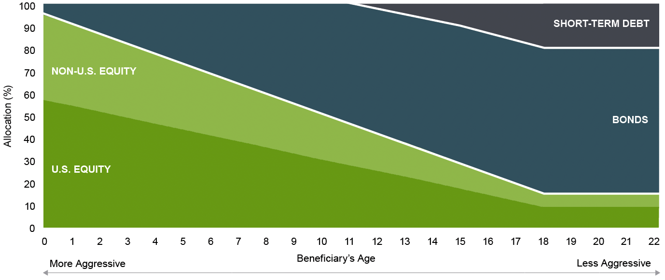
Choose the investment tradition of Fidelity
A Fidelity 529 savings plan offers a fluid, age-based approach to help meet changing allocation needs
ASSET ALLOCATIONS OF AGE-BASED PORTFOLIOS
Allocations shift gradually each year.
These offerings use active asset allocation to over- or underweight certain asset classes to take advantage of market conditions and opportunities.

Slide 13
Fitting a 529 Savings Plan into your overall financial plan
Your financial representative can help guide your investment choice
A Fidelity 529 savings plan offers a range of investment options.
8 Age-Based Portfolios | 2 Static Portfolios | 17+ Individual Portfolios
Funds that gradually shift and regularly rebalance their asset mix based on the age of the beneficiary, lowering investment risk levels as they approach college age. | Funds that seek to maintain a static asset allocation, allowing you to choose an asset mix that aligns with your own risk tolerance. | Funds that enable you to construct a customized portfolio, aligning to your preferred investment exposures, including equity, fixed and stable value.

Slide 14
Invest in a lifetime
Your financial representative can help you build your plan
1
2
3
Open an
account
Let it
grow
Get ready for college
Median earnings of bachelor’s degree recipients with no advanced degree working full-time were
$27K higher⁹
than those of high school graduates.

Slide 15
529 Savings Workplace Program
A great addition to your benefits package
No enrollment cost to the employer
Easy to implement
May improve employee retention
Differentiates your company to prospective employees
Convenient Contribution Options: Checking account withdrawal Payroll direct deposit¹⁰

Slide 16
Fidelity makes participation easy
Simple for you, simple for your employees
Complete an application to open an account
Select deduction amount and investments***
Designate beneficiaries
The employer chooses the contribution method
Participant will receive quarterly statements from Fidelity summarizing all account activity

Slide 17
Your financial representative makes it easier
Your financial representative is at your side throughout the process
Assists you in plan implementation
Helps you choose the appropriate funding options
Provides material to encourage employee participation
May conduct employee enrollment training
Helps employees select investments
Communicates plan enhancements

Slide 18
i.fidelity.com/529
If your client or the designated beneficiary is not a resident of the state offering the 529 plan, they may want to consider, before investing, whether their state or the designated beneficiary’s home state offers its residents a plan with alternate state tax advantages or other state benefits, such as financial aid, scholarship funds, and protection from creditors.
Units of the portfolios are municipal securities and may be subject to market volatility and fluctuation.
Not NCUA or NCUSIF insured. May lose value. No credit union guarantee.
Unless specifically indicated in an investment option’s detailed description, principal invested is not guaranteed at any time, including at or after the target date.
Consider your current and anticipated investment horizon and income tax bracket when making an investment decision, as the illustrations presented may not reflect these factors. Systematic investing does not ensure a profit and does not limit loss in a declining market. All hypothetical examples are for illustrative purposes only and do not represent the performance of any security. The assumed rate of return used in these examples is not guaranteed, and you may have a gain or loss when you sell your units. Investments that have potential for a 7% annual rate of return also come with risk of loss.
The tax and estate planning information contained herein is general in nature, is provided for informational purposes only, and should not be construed as legal or tax advice. Fidelity does not provide legal or tax advice. Fidelity cannot guarantee that such information is accurate, complete, or timely. Laws of a particular state or laws that may be applicable to a particular situation may have an impact on the applicability, accuracy, or completeness of such information. Federal and state laws and regulations are complex and are subject to change. Changes in such laws and regulations may have a material impact on pre- and/or after-tax investment results. Fidelity makes no warranties with regard to such information or results obtained by its use. Fidelity disclaims any liability arising out of your use of, or any tax position taken in reliance on, such information.
Always consult an attorney or tax professional regarding your specific legal or tax situation.
Before investing, consider the plans’ investment objectives, risks, charges, and expenses. Contact Fidelity or visit i.fidelity.com for a free Offering Statement. Read it carefully before investing.
957563.15.0
FIDELITY DISTRIBUTORS COMPANY LLC, 500 SALEM STREET, SMITHFIELD, RI 02917
1.9905310.103
0125

